Slide 1
Getting credit for sharing your data (Part I):
Good enough data management practices
Alaina Pearce
Open Science Bootcamp 2025

Slide 2
Project vs Data Management
Data Management
Project Management
data sources &
acquisitions
regulatory policies
& processes
storage & backups
methods &
protocols
aims &
purpose
data processing
data analysis
future
goals
staffing & training
data archiving
timeline/milestones
documentation
& metadata
equipment, tools,
software
Goal: extract meaningful insight and information
Goal: meet project goals within set timelines

Slide 3
With what time???

Slide 4

‘Good Enough’
  (relatively) low effort
  shallow learning curve
  beneficial to current and future you
  increases ‘openness’ of research

Slide 5
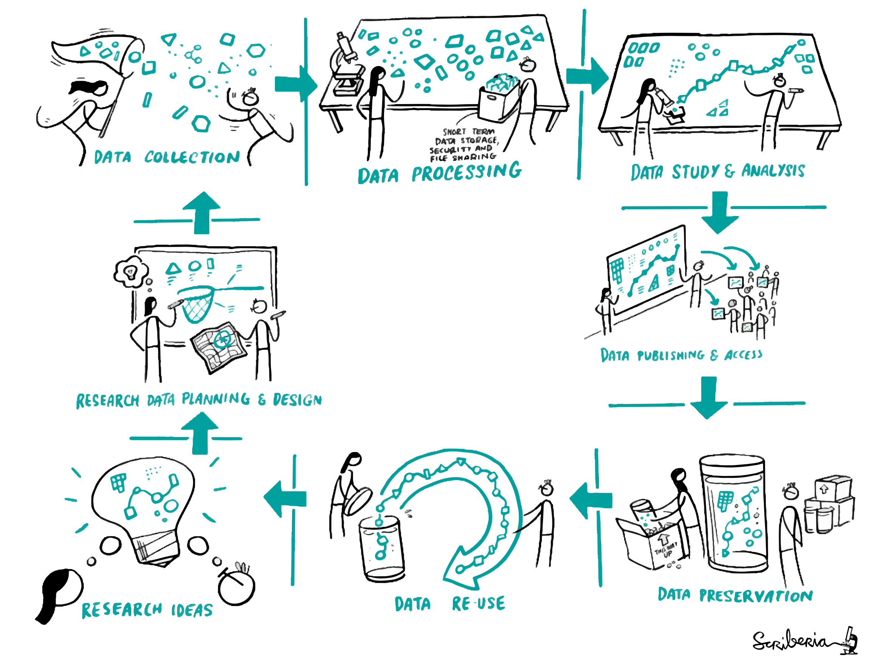
Project Lifecycle
The Turing Way project illustration by Scriberia. Used under a CC-BY 4.0 license. DOI: 10.5281/zenodo.3332807.

Slide 6
Project Lifecycle
The Turing Way project illustration by Scriberia. Used under a CC-BY 4.0 license. DOI: 10.5281/zenodo.3332807.

Slide 7
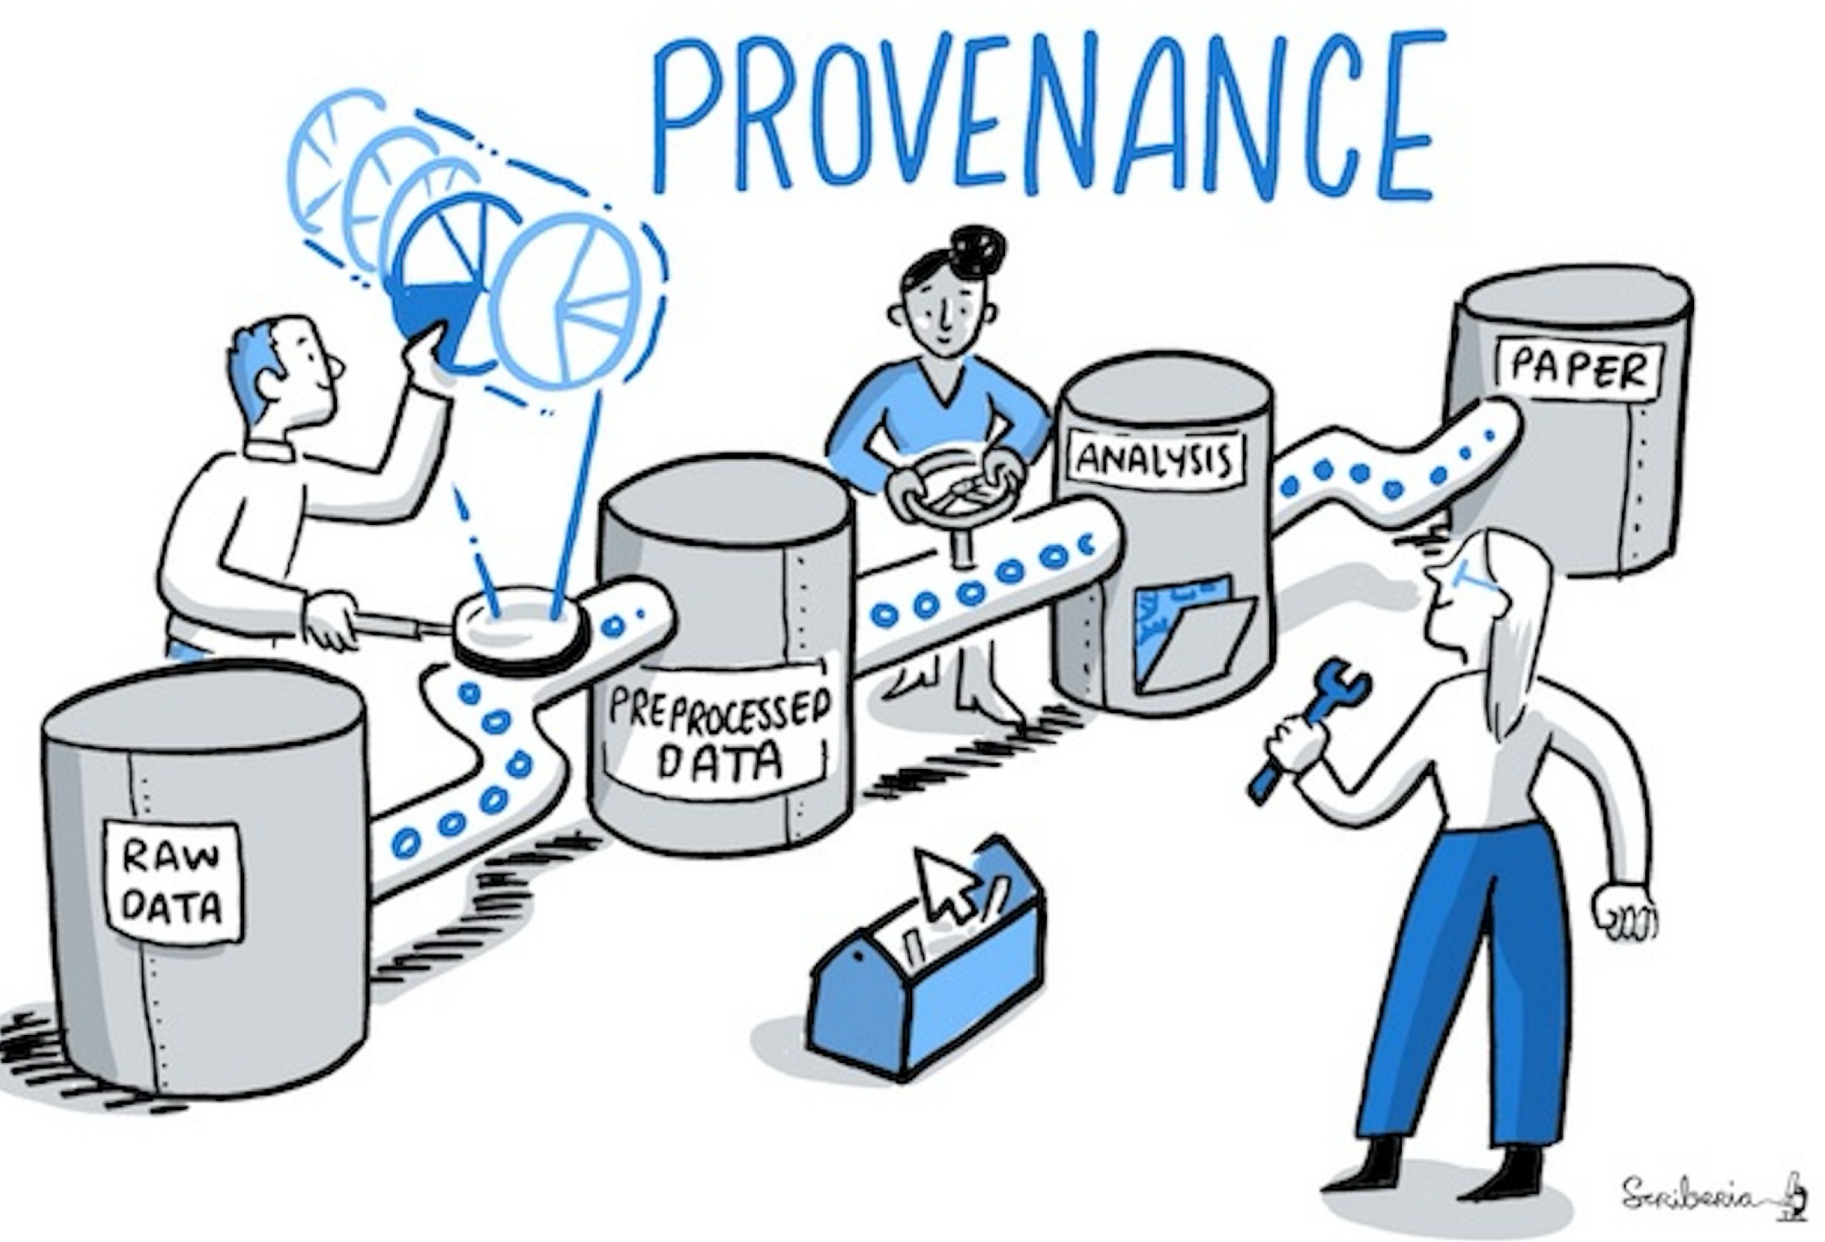
Data Processing Pipelines
The Turing Way project illustration by Scriberia. Used under a CC-BY 4.0 license. DOI: 10.5281/zenodo.3332807.

Slide 8



1. Preserve Raw Data
  Raw Data: data as it was originally collected
  Save in data in its original form and DO NOT alter or ‘improve’ it

Slide 9
1. Preserve Raw Data
  Raw Data: data as it was originally collected
  What makes this ‘Open’?
  Stable starting point
  Test reproducibility of pipeline
  Recover from mishaps
  Experiment without fear
  Save in data in its original form and DO NOT alter or ‘improve’ it

Slide 10
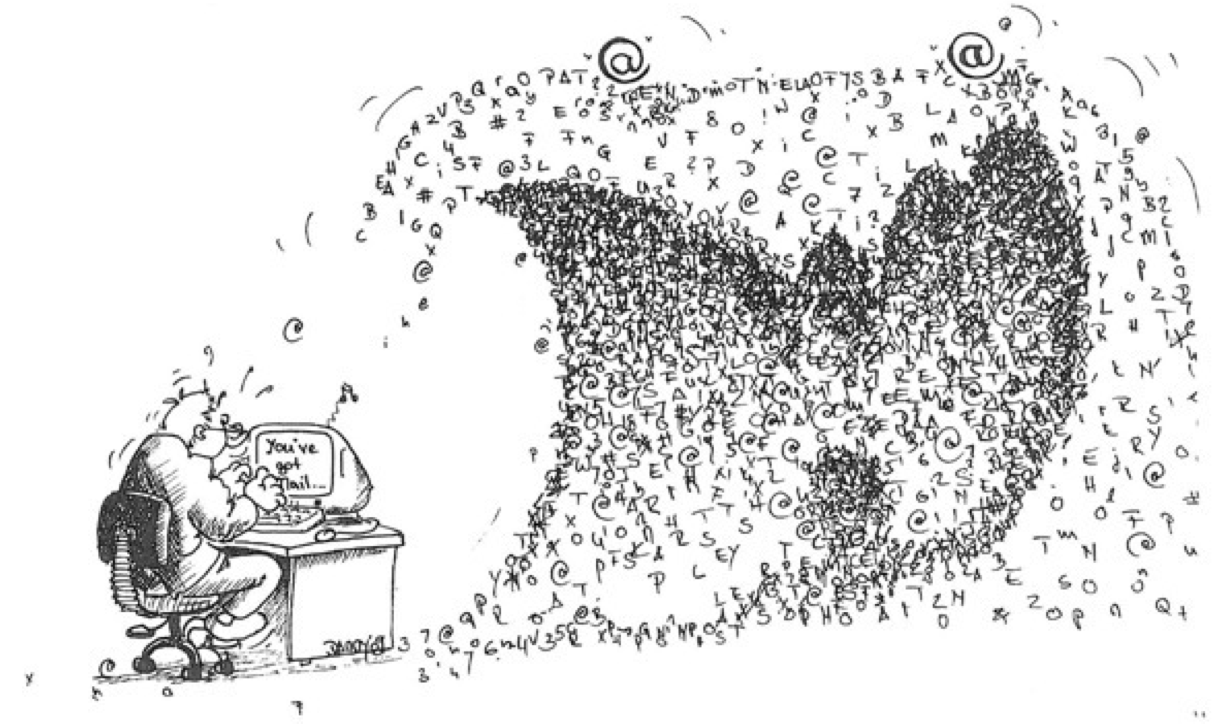
Data Tsunami

Slide 11
2. Create a Central Hub
  Goals:
    Identify file/contents in a clear way
    Have a consistent approach across projects and collaborators
    Should be meaningful but brief
The Turing Way project illustration by Scriberia. Used under a CC-BY 4.0 license. DOI: 10.5281/zenodo.3332807.

Slide 12
Create a Central Hub
  Directory Structures: organization of files into a hierarchical structure
  Create a directory for each project
  Use a consistent structure
  Separate data management from project management
  Keep subfolder categories narrow to limit number of files in each one

Slide 13
2. Create a Central Hub
  Directory Structures: organization of files into a hierarchical structure

Slide 14
2. Create a Central Hub
  Directory Structures: organization of files into a hierarchical structure
  What makes this ‘Open’?
  Easy to find data, code, protocol
  Consistent (at least within lab)
  Bigger Lift: match field standards (e.g. , BIDS, MIxS)

Slide 15
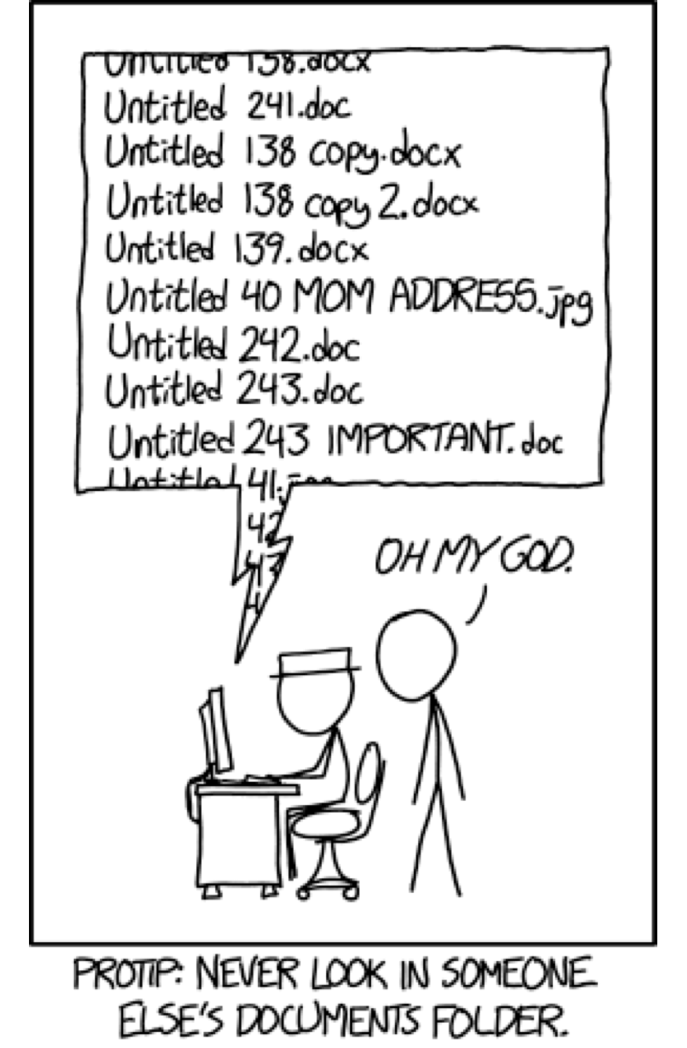
3. Use Meaningful Names
  Goals:
    Identify file/contents in a clear way
    Have a consistent approach across projects and collaborators
    Should be meaningful but brief

Slide 16
3. Use Meaningful Names
  Leverage filenames to help you manage complex projects
  Human Readable: names should clearly describe content in the simplest way possible (e.g., ‘code’, ‘data’)
  Computer Readable: ability of a computer to parse a name
    Use ‘-‘ or ‘_’ in place of spaces
    No special characters (e.g, ‘&’, ‘#’, ‘^’, etc)

Slide 17
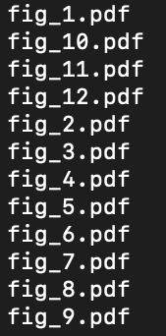
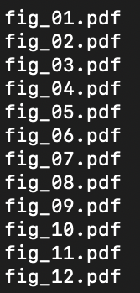
3. Use Meaningful Names
  Leverage filenames to help you manage complex projects
  Human Readable: names should clearly describe content in the simplest way possible (e.g., ‘code’, ‘data’)
  Computer Readable: ability of a computer to parse a name
    Use ‘-‘ or ‘_’ in place of spaces
    No special characters (e.g, ‘&’, ‘#’, ‘^’, etc)
  Sortable: help you find what you need in the future
    Dates: YYYY-MM-DD
    Study IDs: Pad with zeros

Slide 18
3. Use Meaningful Names
  Leverage filenames to help you manage complex projects
  Do NOT Use
  Spaces
  Periods (except for file extensions)
  Other special characters (&, *, ^, etc)
  DO Use
  CamelCase
  snake_case
  YYYYMMDD date format
  Pad numbers with zeros (e.g., 001)

Slide 19
Key-Value Pairs in the Brain Imaging Data Structure (BIDS):
  sub-035_task-memory_events.txt
  sub-035_ses-2_task-memory_events.txt
3. Use Meaningful Names
  Leverage filenames to help you manage complex projects
  https://bids-standard.github.io/bids-starter-kit/folders_and_files/files.html

Slide 20
3. Use Meaningful Names
  Leverage filenames to help you manage complex project
  Human Readable: names should clearly describe content in the simplest way possible (e.g., ‘code’, ‘data’)
  Computer Readable: ability of a computer to parse a name
    Use ‘-‘ or ‘_’ in place of spaces
    No special characters (e.g, ‘&’, ‘#’, ‘^’, etc)
  Sortable: help you find what you need in the future
    Dates: YYYY-MM-DD
    Study IDs: Pad with zeros
  What makes this ‘Open’?
  Makes data more findable
  Can be a form of metadata
  Bigger Lift: adopt field standards

Slide 21
Worksheet - Directory Structures and File Naming

Slide 22
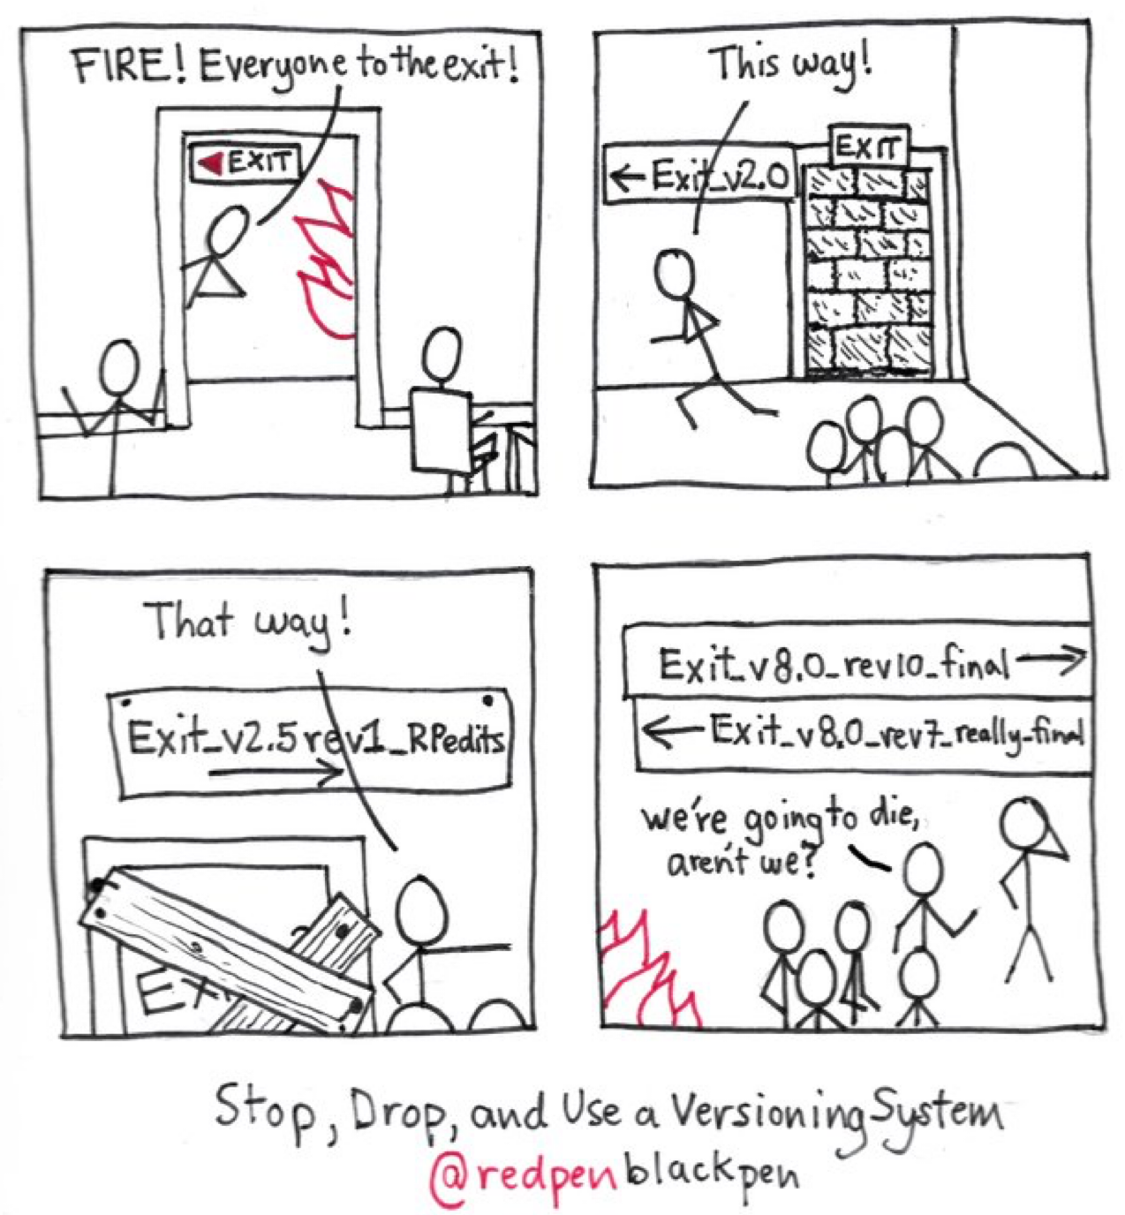
4. Preserve the Journey
  Version control: tracking and managing changes to documents or code

Slide 23
4. Preserve the Journey
  Version control: tracking and managing changes to documents or code
  Manual: use file naming to document drafts (e.g., dates, version numbers)
  Software: git, GitHub, subversion
  Allows you to trace your steps

Slide 24

4. Preserve the Journey
  Version control: tracking and managing changes to documents or code
  Manual: use file naming to document drafts (e.g., dates, version numbers)
  Software: git, GitHub, subversion
  Allows you to trace your steps
  99 little bugs in the code
  99 little bugs
  Take one down and compile it
  117 little bugs in the code…

Slide 25
4. Preserve the Journey
  Version control: tracking and managing changes to documents or code
  What makes this ‘Open’?
  Documents project and data history
  Can reproduce process if needed
  Bigger Lift: use a version control software (e.g., git)
  Manual: use file naming to document drafts (e.g., dates, version numbers)
  Software: git, GitHub, subversion
  Allows you to trace your steps

Slide 26
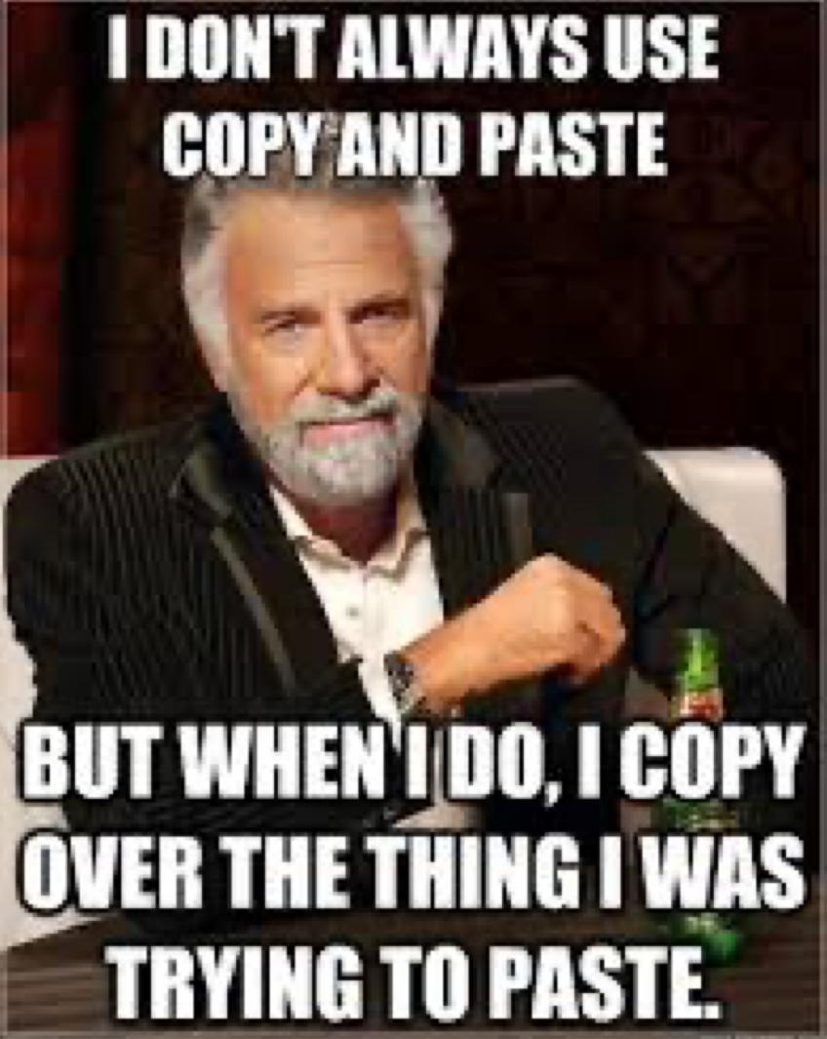
5. Avoid manual manipulations
  Manual data manipulations leave no trace
    Hard to reproduce
    Error prone
  Alternatives:
    Save Syntax in SPSS
    Include calculations in variable descriptions
    Script data cleaning

Slide 27
5. Avoid manual manipulations
  Manual data manipulations leave no trace
    Hard to reproduce
    Error prone
  Alternatives:
    Save Syntax in SPSS
    Include calculations in variable descriptions
    Script data cleaning

Slide 28
5. Avoid manual manipulations
  Manual data manipulations leave no trace
    Hard to reproduce
    Error prone
  Alternatives:
    Save Syntax in SPSS
    Include calculations in variable descriptions
    Script data cleaning
  What makes this ‘Open’?
  Data processing will be reproducible
  Can reverse to original data if needed
  Bigger Lift: move away from GUI-based analysis software to open code/syntax based programs (e.g., R, python)

Slide 29
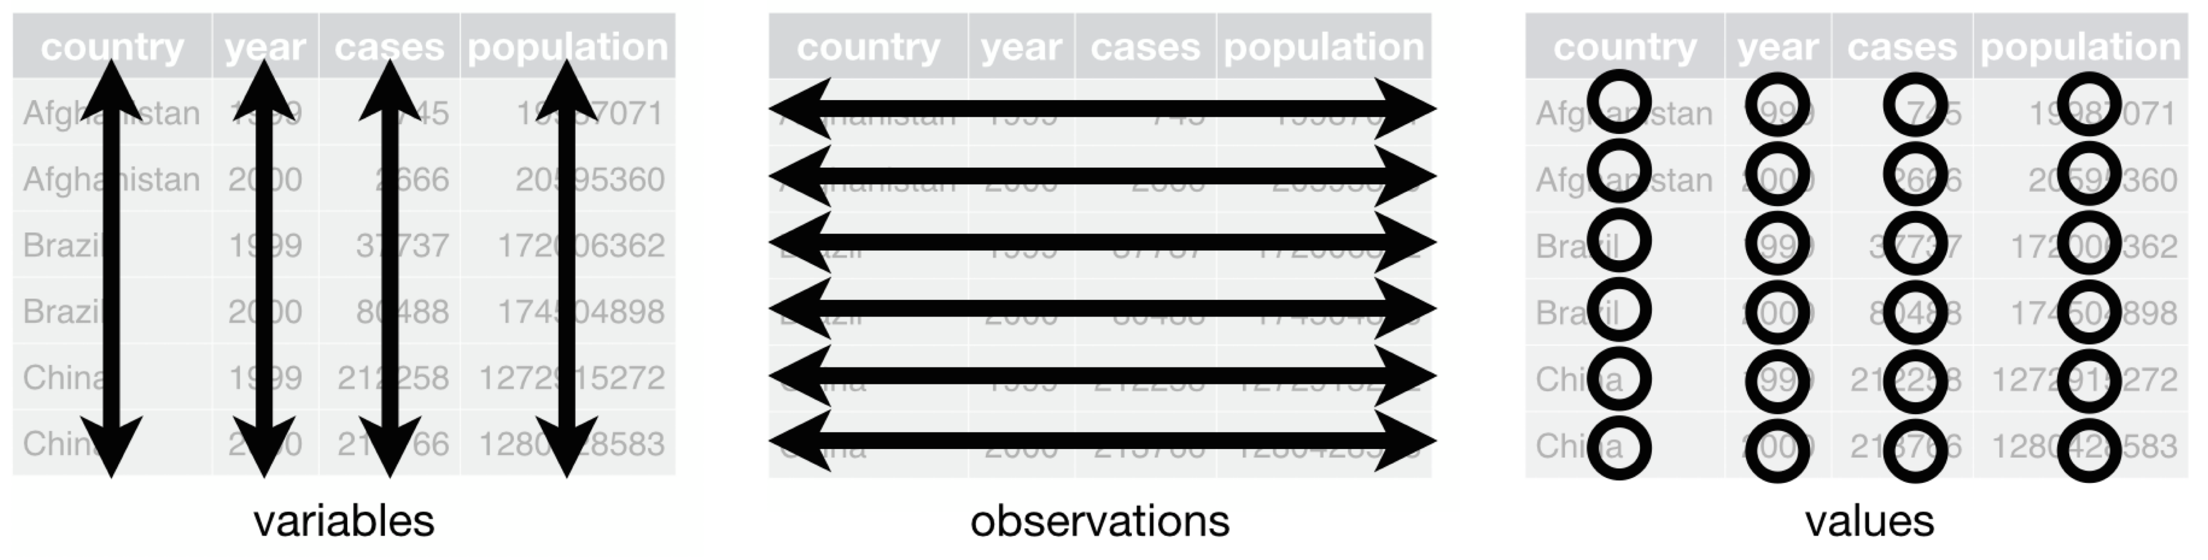
6. ‘Tidy’ your data
  Every variable is in its own column
  Each participant/sample is in its own row
  Each value is in its own cell

Slide 30
6. ‘Tidy’ your data
  Use open file formats — csv, html, txt, jpeg

Slide 31
6. ‘Tidy’ your data
  Use open file formats — csv, html, txt, jpeg
  Create a data dictionary

Slide 32
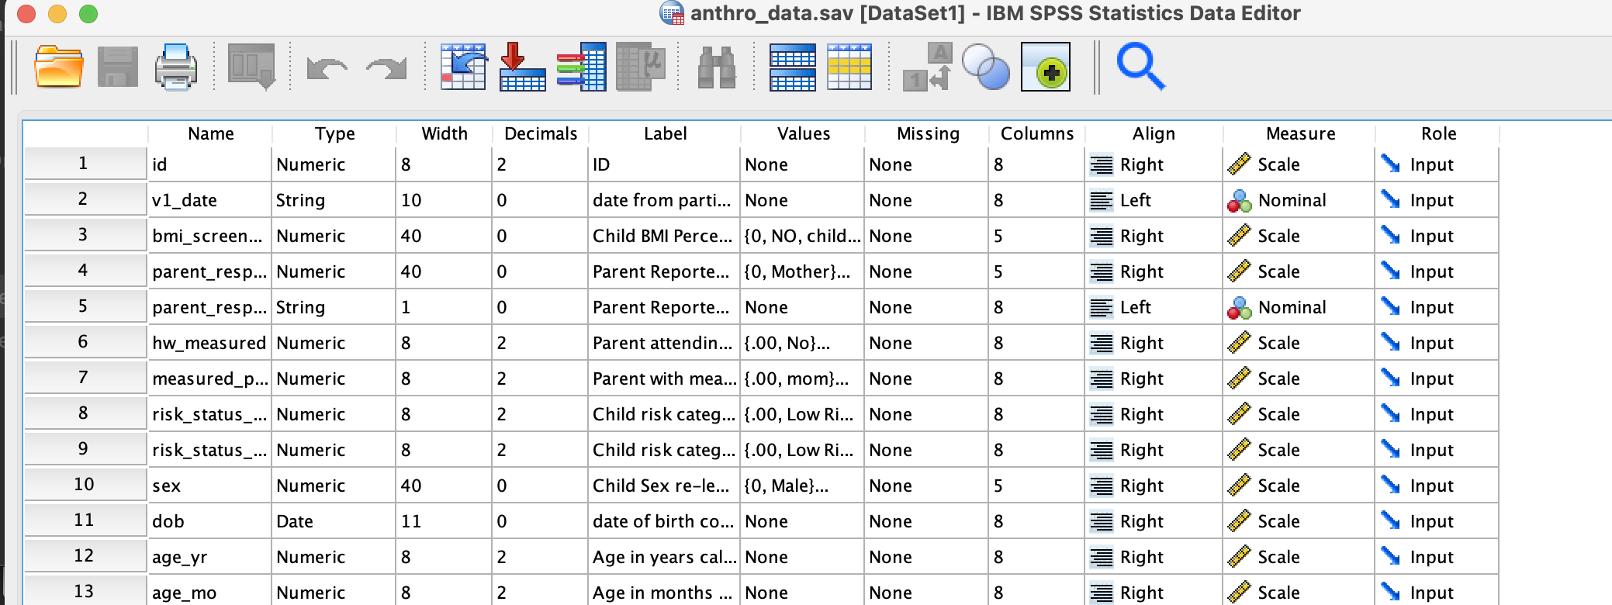
6. ‘Tidy’ your data
  Use open file formats — csv, html, txt, jpeg
  Create a data dictionary

Slide 33
6. ‘Tidy’ your data
  Use open file formats — csv, html, txt, jpeg
  Create a data dictionary
  One piece of information per cell
height
5 ft 6 in
5 ft 2 in
7 ft
5 ft 11 in
height_ft | height_in
5 | 6
5 | 2
7 | 0
5 | 11

Slide 34
6. ‘Tidy’ your data
  Use open file formats — csv, html, txt, jpeg
  Create a data dictionary
  One piece of information per cell
  Do not use highlighting/font color as data
height
5 ft 6 in
5 ft 2 in
7 ft
5 ft 11 in
height_ft | height_in | check_height
5 | 6 | 0
5 | 2 | 0
7 | 0 | 1
5 | 11 | 0

Slide 35
6. ‘Tidy’ your data
  Use open file formats — csv, html, txt, jpeg
  Create a data dictionary
  One piece of information per cell
  Do not use highlighting/font color as data
  What makes this ‘Open’?
  Open formats are accessible
  All data are computer readable
  Data are documented
  Makes data re-use and sharing easier

Slide 36
7. Metadata Magic
  Metadata: the who, what, when, where, and why of your data
  Easiest: when in doubt, document
    Data dictionaries
    Standard operating procedures manuals
    Lab notebooks
    changelog file (document versions)
    README
      Description of folders/files
      Can provide instructions on use of code/data
      License information

Slide 37
7. Metadata Magic
  Metadata: the who, what, when, where, and why of your data
  Medium Effort: Data Manual
    Larger
    More verbose and detailed
    Can include science/rational/citations
    Like a user manual for data

Slide 38
7. Metadata Magic
  Metadata: the who, what, when, where, and why of your data
  Bigger Lift: Structured Metadata
    Often laid out in fields
    Can require use of shared vocabularies
    Often field/data type specific

Slide 39
7. Metadata Magic
  Metadata: the who, what, when, where, and why of your data
  Bigger Lift: Structured Metadata
    Often laid out in fields
    Can require use of shared vocabularies
    Often field/data type specific
  What makes this ‘Open’?
  Makes data more findable
  Helps others (and future you) understand the data
  Shared vocabularies help to harmonize data within a field

Slide 40

‘Good Enough’ Practices
  Preserve Raw Data
  Create a Central Hub
  Use Meaningful Names
  Preserve the Journey
  Avoid Manual Manipulations
  ‘Tidy’ Your Data
  Metadata Magic

