Slide 1
Getting Credit (Part I): “Good enough” Data Management Practices
Alaina Pearce
Open Scholarship Bootcamp
5/11/2026

Slide 2

Provost Endorsement:
Research Data Stewardship
Workshops:
Research Data Management (this one)
Data Documentation (later this afternoon)
Research Data Policy (at least once a semester on zoom)
Activities:
Document a dataset
Create a Research Data Strategy (like an SOP for data)
Register

Slide 3
Project vs Data Management
Data Management
Project Management
data sources &
acquisitions
regulatory policies
& processes
storage & backups
methods &
protocols
aims &
purpose
data processing
data analysis
future
goals
staffing & training
data archiving
timeline/milestones
documentation
& metadata
equipment, tools,
software
Goal: extract meaningful insight and information
Goal: meet project goals within set timelines

Slide 4
With what time???

Slide 5

‘Good Enough’
(relatively) low effort
shallow learning curve
beneficial to current and future you
increases ‘openness’ of research

Slide 6
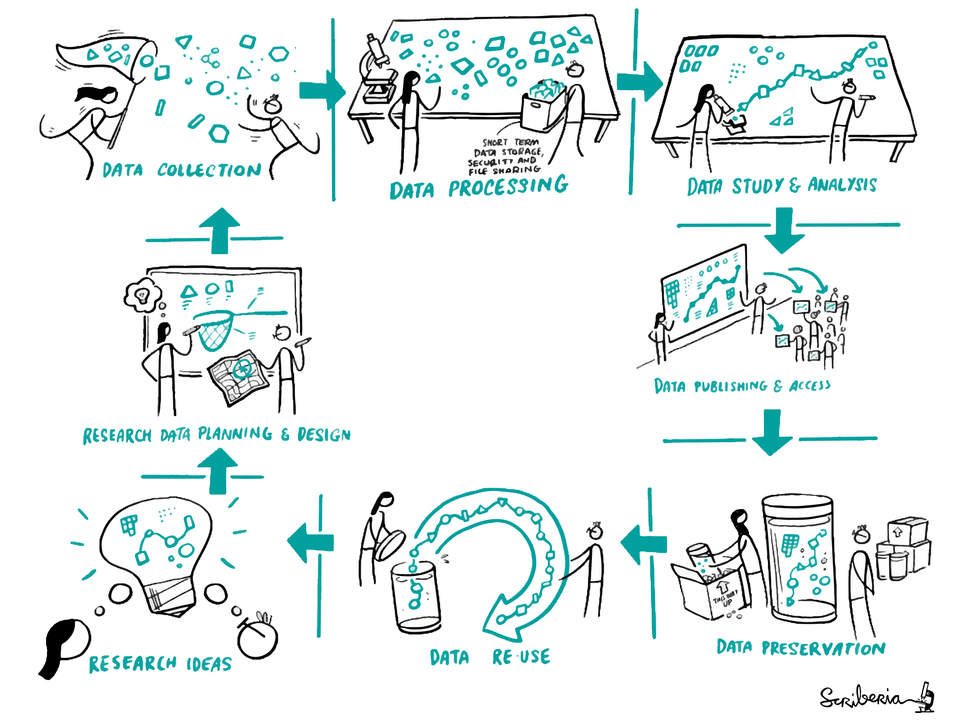
Project Lifecycle
The Turing Way project illustration by Scriberia. Used under a CC-BY 4.0 license. DOI: 10.5281/zenodo.3332807.

Slide 7
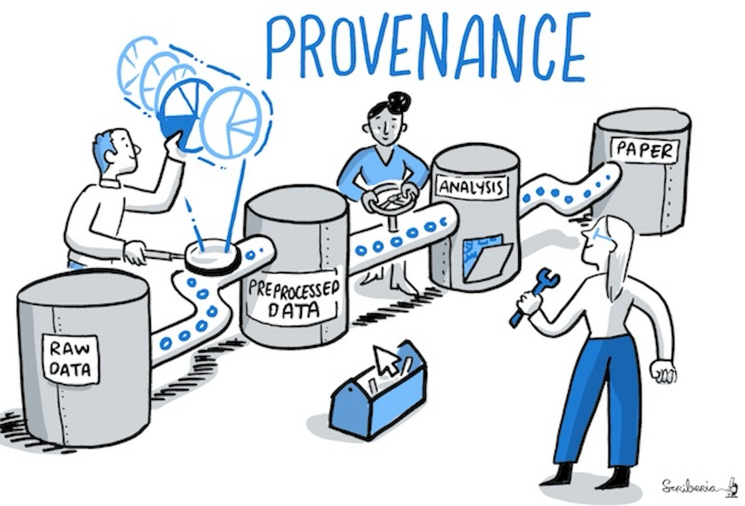
Data Processing Pipelines
The Turing Way project illustration by Scriberia. Used under a CC-BY 4.0 license. DOI: 10.5281/zenodo.3332807.

Slide 8



1. Preserve Raw Data
Raw Data: data as it was originally collected
What makes this ‘Open’?
Stable starting point
Test reproducibility of pipeline
Recover from mishaps
Experiment without fear
Save in data in its original form and DO NOT alter or ‘improve’ it

Slide 9
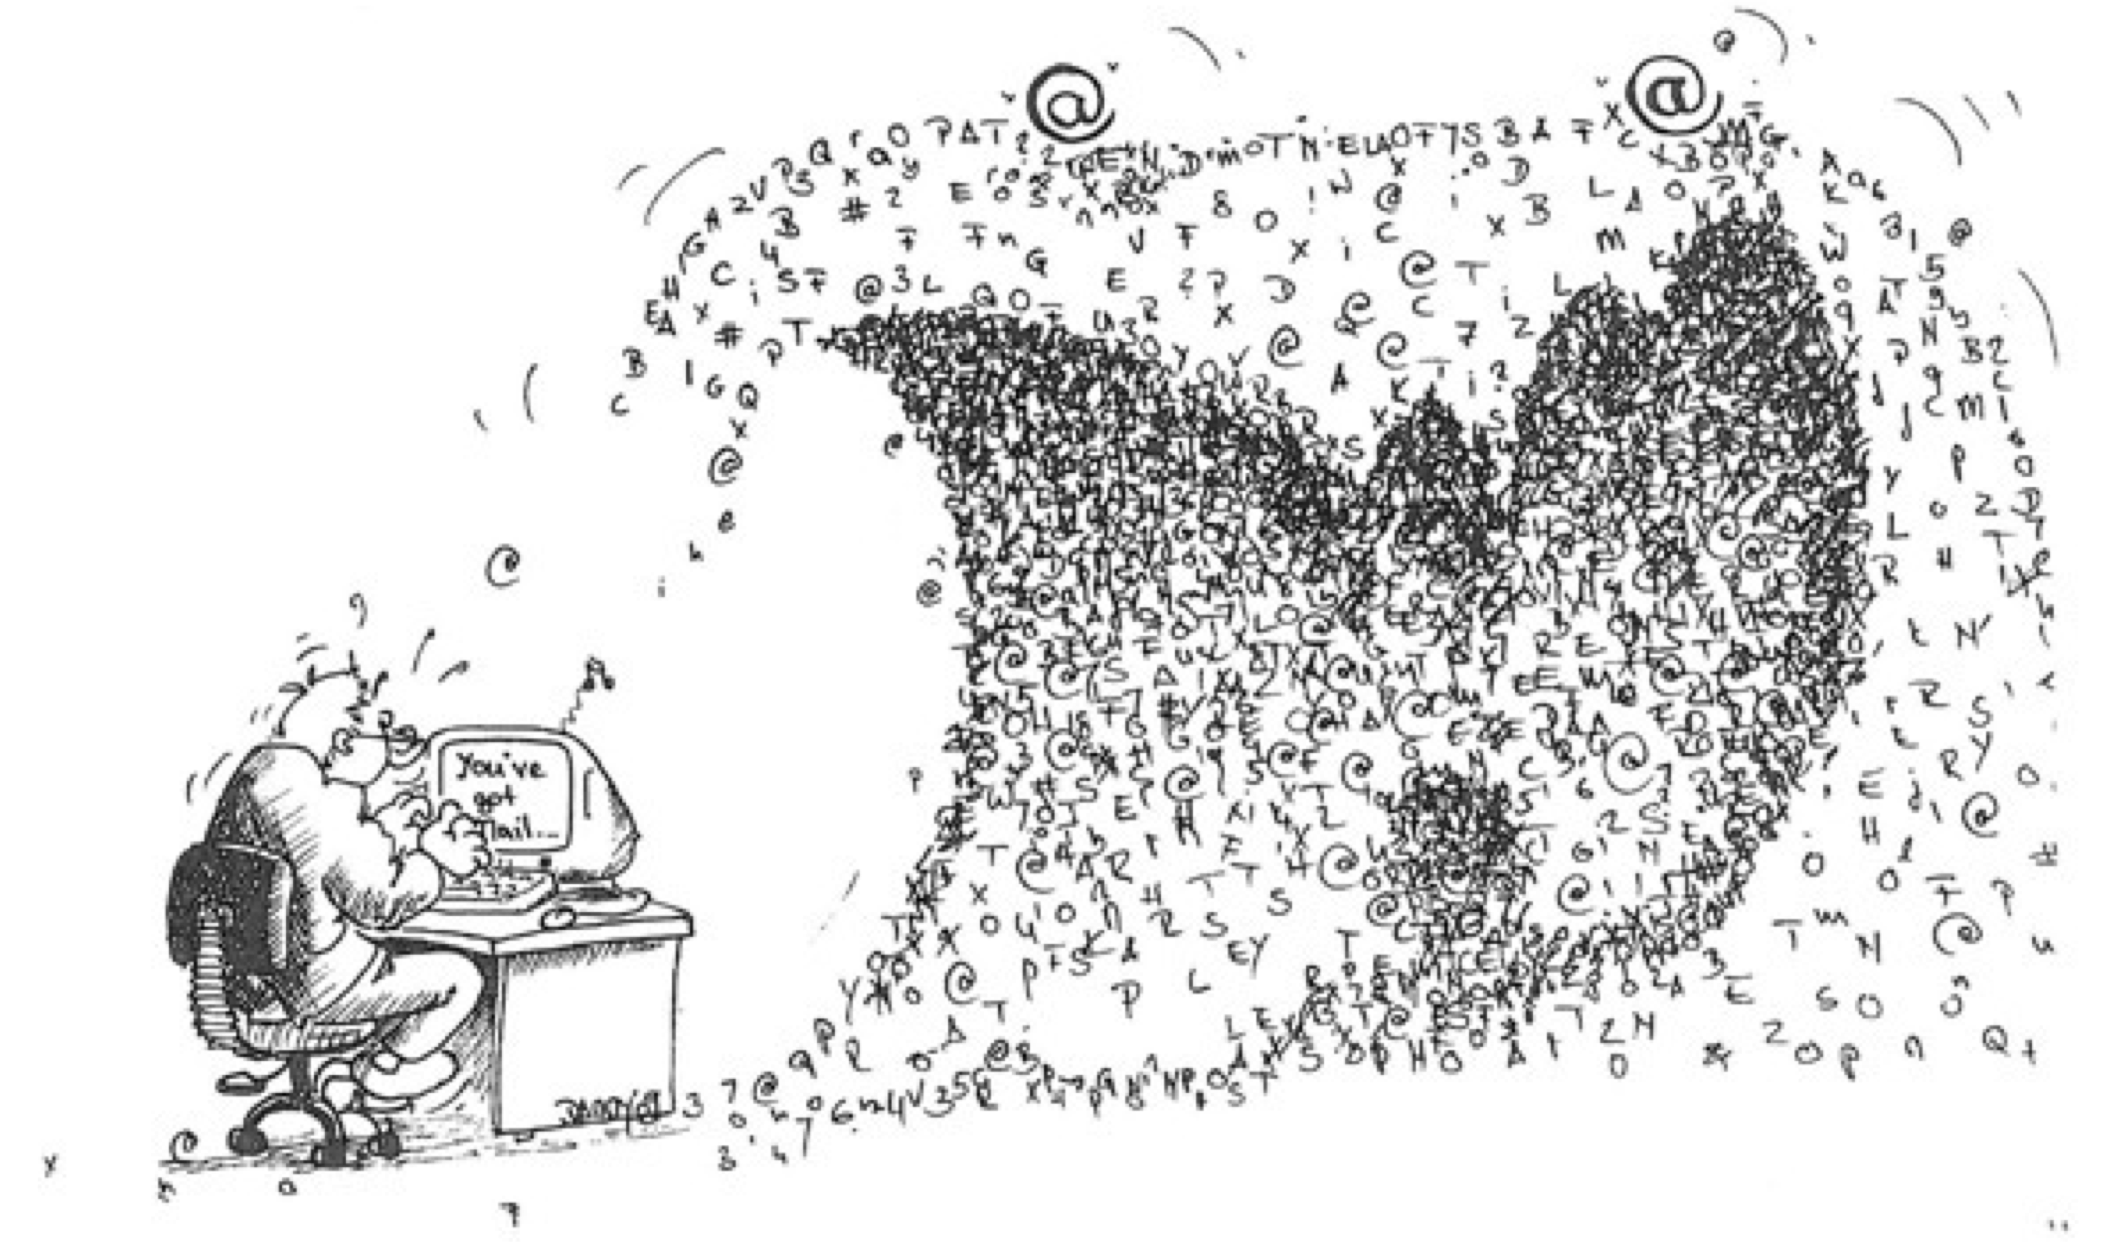
Data Tsunami

Slide 10
2. Create a Central Hub
Goals:
Identify file/contents in a clear way
Have a consistent approach across projects and collaborators
Should be meaningful but brief
The Turing Way project illustration by Scriberia. Used under a CC-BY 4.0 license. DOI: 10.5281/zenodo.3332807.

Slide 11
2. Create a Central Hub
Directory Structures: organization of files into a hierarchical structure
Create a directory for each project
Use a consistent structure
Separate data management from project management
Keep subfolder categories narrow to limit number of files in each one

Slide 12
2. Create a Central Hub
Directory Structures: organization of files into a hierarchical structure
What makes this ‘Open’?
Easy to find data, code, protocol
Consistent (at least within lab)
Bigger Lift: match field standards (e.g. , BIDS, MIxS)

Slide 13
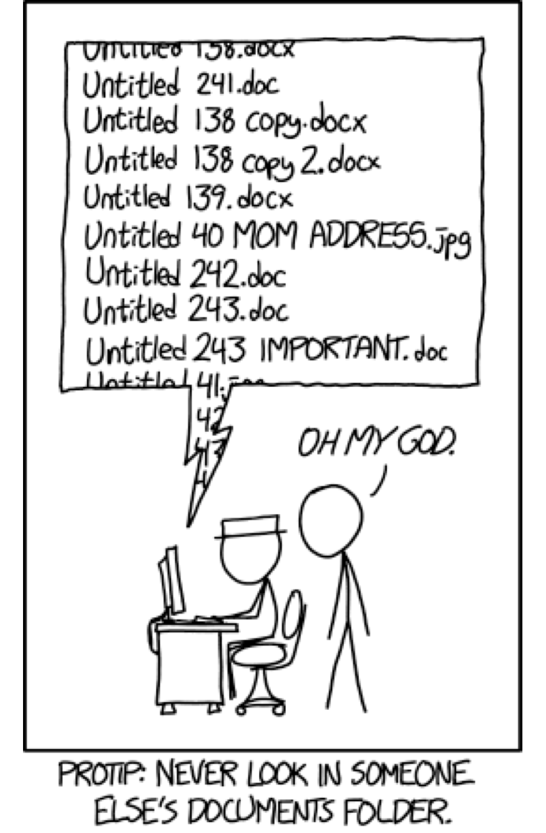
3. Use Meaningful Names
Goals:
Identify file/contents in a clear way
Have a consistent approach across projects and collaborators
Should be meaningful but brief

Slide 14
3. Use Meaningful Names
Leverage filenames to help you manage complex projects
Human Readable: names should clearly describe content in the simplest way possible (e.g., ‘code’, ‘data’)
Computer Readable: ability of a computer to parse a name
Use ‘-‘ or ‘_’ in place of spaces
No special characters (e.g, ‘&’, ‘#’, ‘^’, etc)

Slide 15
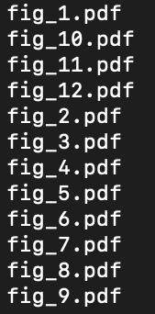
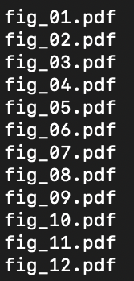
3. Use Meaningful Names
Leverage filenames to help you manage complex projects
Human Readable: names should clearly describe content in the simplest way possible (e.g., ‘code’, ‘data’)
Computer Readable: ability of a computer to parse a name
Use ‘-‘ or ‘_’ in place of spaces
No special characters (e.g, ‘&’, ‘#’, ‘^’, etc)
Sortable: help you find what you need in the future
Dates: YYYY-MM-DD
Study IDs: Pad with zeros

Slide 16
3. Use Meaningful Names
Leverage filenames to help you manage complex projects
Do NOT Use
Spaces
Periods (except for file extensions)
Other special characters (&, *, ^, etc)
DO Use
CamelCase
snake_case
YYYYMMDD date format
Pad numbers with zeros (e.g., 001)

Slide 17
Key-Value Pairs in the Brain Imaging Data Structure (BIDS):
sub-035_task-memory_events.txt
sub-035_ses-2_task-memory_events.txt
3. Use Meaningful Names
Leverage filenames to help you manage complex projects
https://bids-standard.github.io/bids-starter-kit/folders_and_files/files.html

Slide 18
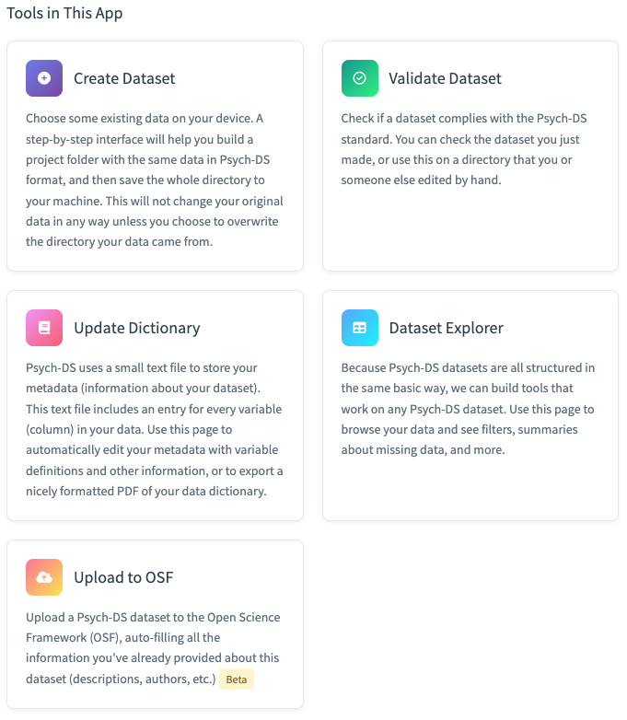
Psych-DS
Relatively simple, general data that can be used for data that does not fall under other data standards.
Has online validator
Has R shiny app to help build documentation via a GUI
3. Use Meaningful Names
Leverage filenames to help you manage complex projects
https://psych-ds.github.io/psychds-r/

Slide 19
3. Use Meaningful Names
Leverage filenames to help you manage complex project
Human Readable: names should clearly describe content in the simplest way possible (e.g., ‘code’, ‘data’)
Computer Readable: ability of a computer to parse a name
Use ‘-‘ or ‘_’ in place of spaces
No special characters (e.g, ‘&’, ‘#’, ‘^’, etc)
Sortable: help you find what you need in the future
Dates: YYYY-MM-DD
Study IDs: Pad with zeros
What makes this ‘Open’?
Makes data more findable
Can be a form of metadata
Bigger Lift: adopt field standards

Slide 20
Hands On - Directory Structures and File Naming

Slide 21
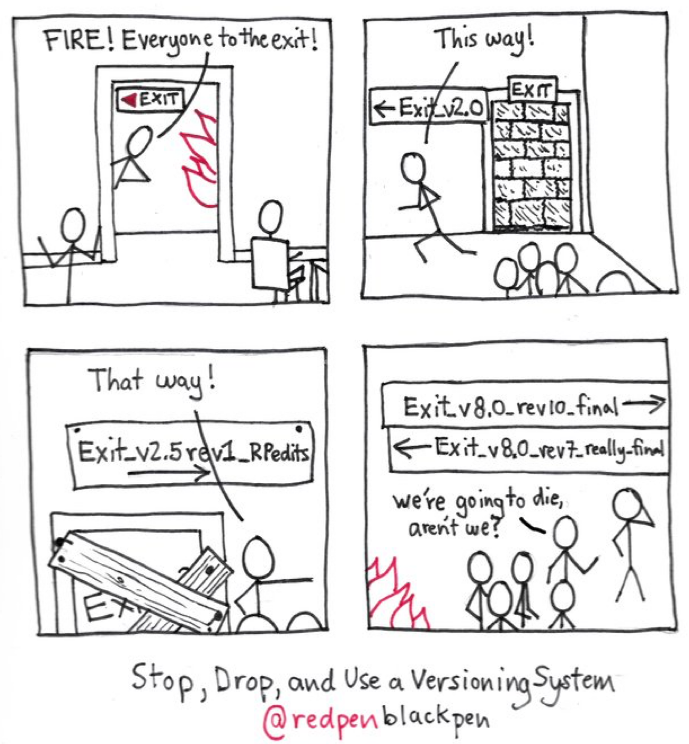
4. Preserve the Journey
Version control: tracking and managing changes to documents or code

Slide 22
4. Preserve the Journey
Version control: tracking and managing changes to documents or code
Manual: use file naming to document drafts (e.g., dates, version numbers)
Software: git, GitHub, subversion
Allows you to trace your steps

Slide 23

4. Preserve the Journey
Version control: tracking and managing changes to documents or code
Manual: use file naming to document drafts (e.g., dates, version numbers)
Software: git, GitHub, subversion
Allows you to trace your steps
99 little bugs in the code
99 little bugs
Take one down and compile it
117 little bugs in the code…

Slide 24
4. Preserve the Journey
Version control: tracking and managing changes to documents or code
What makes this ‘Open’?
Documents project and data history
Can reproduce process if needed
Bigger Lift: use a version control software (e.g., git)
Manual: use file naming to document drafts (e.g., dates, version numbers)
Software: git, GitHub, subversion
Allows you to trace your steps

Slide 25
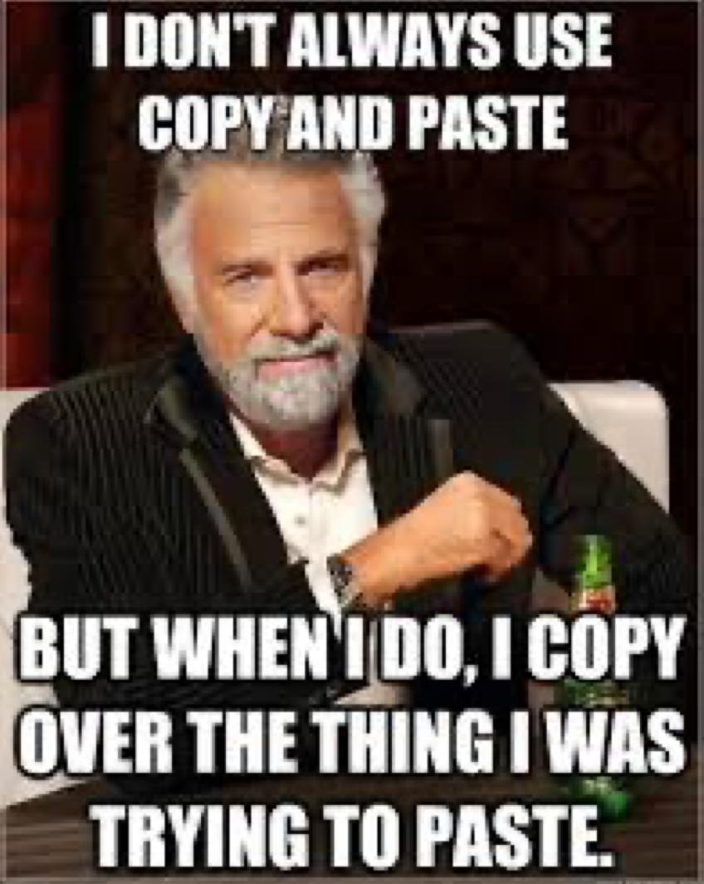
5. Avoid manual manipulations
Manual data manipulations leave no trace
Hard to reproduce
Error prone
Alternatives:
Save Syntax in SPSS
Include calculations in variable descriptions
Script data cleaning

Slide 26
5. Avoid manual manipulations
Manual data manipulations leave no trace
Hard to reproduce
Error prone
Alternatives:
Save Syntax in SPSS
Include calculations in variable descriptions
Script data cleaning

Slide 27
5. Avoid manual manipulations
Manual data manipulations leave no trace
Hard to reproduce
Error prone
Alternatives:
Save Syntax in SPSS
Include calculations in variable descriptions
Script data cleaning
What makes this ‘Open’?
Data processing will be reproducible
Can reverse to original data if needed
Bigger Lift: move away from GUI-based analysis software to open code/syntax based programs (e.g., R, python)

Slide 28
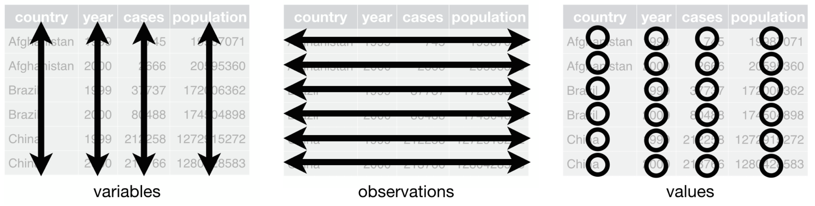
6. ‘Tidy’ your data
Every variable is in its own column
Each participant/sample is in its own row
Each value is in its own cell

Slide 29
6. ‘Tidy’ your data
Use open file formats — csv, html, txt, jpeg

Slide 30
6. ‘Tidy’ your data
Use open file formats — csv, html, txt, jpeg
Create a data dictionary

Slide 31
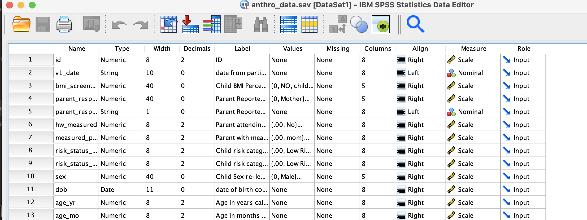
6. ‘Tidy’ your data
Use open file formats — csv, html, txt, jpeg
Create a data dictionary

Slide 32
6. ‘Tidy’ your data
Use open file formats — csv, html, txt, jpeg
Create a data dictionary
One piece of information per cell
height
5 ft 6 in
5 ft 2 in
7 ft
5 ft 11 in
height_ft | height_in
5 | 6
5 | 2
7 | 0
5 | 11

Slide 33
6. ‘Tidy’ your data
Use open file formats — csv, html, txt, jpeg
Create a data dictionary
One piece of information per cell
Do not use highlighting/font color as data
height
5 ft 6 in
5 ft 2 in
7 ft
5 ft 11 in
height_ft | height_in | check_height
5 | 6 | 0
5 | 2 | 0
7 | 0 | 1
5 | 11 | 0

Slide 34
6. ‘Tidy’ your data
Use open file formats — csv, html, txt, jpeg
Create a data dictionary
One piece of information per cell
Do not use highlighting/font color as data
What makes this ‘Open’?
Open formats are accessible
All data are computer readable
Data are documented
Makes data re-use and sharing easier

Slide 35
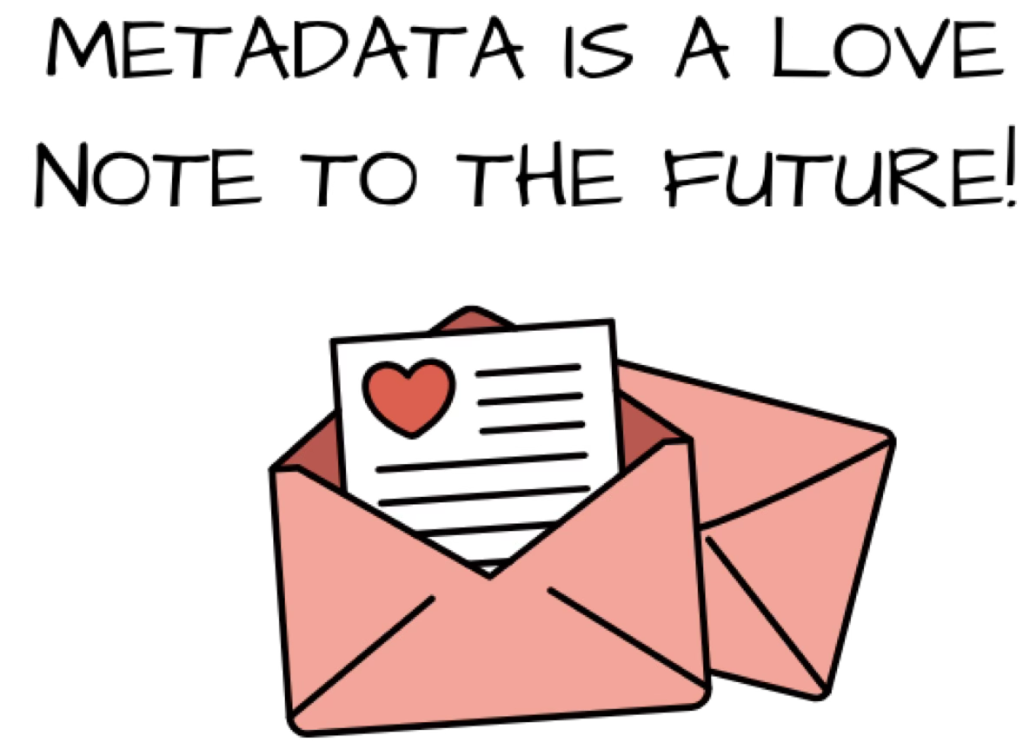
7. Metadata Magic
Metadata: the who, what, when, where, and why of your data
Easiest: when in doubt, document
Data dictionaries
Standard operating procedures manuals
Lab notebooks
changelog file (document versions)
README
Description of folders/files
Can provide instructions on use of code/data
License information

Slide 36
7. Metadata Magic
Metadata: the who, what, when, where, and why of your data
Medium Effort: Data Manual
Larger
More verbose and detailed
Can include science/rational/citations
Like a user manual for data

Slide 37
7. Metadata Magic
Metadata: the who, what, when, where, and why of your data
Bigger Lift: Structured Metadata
Often laid out in fields
Can require use of shared vocabularies
Often field/data type specific

Slide 38
7. Metadata Magic
Metadata: the who, what, when, where, and why of your data
Bigger Lift: Structured Metadata
Often laid out in fields
Can require use of shared vocabularies
Often field/data type specific
What makes this ‘Open’?
Makes data more findable
Helps others (and future you) understand the data
Shared vocabularies help to harmonize data within a field

Slide 39

‘Good Enough’ Practices
Preserve Raw Data
Create a Central Hub
Use Meaningful Names
Preserve the Journey
Avoid Manual Manipulations
‘Tidy’ Your Data
Metadata Magic

Slide 40

Provost Endorsement:
Research Data Stewardship
1. Register
2. Workshop Completion

Slide 41
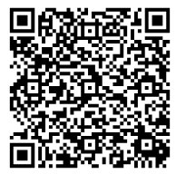
Institutional Tools & Resources
Research Data Stewardship Program
Free Consultations:
Data Visualization
Data Sharing
Statistical Results Interpretation
Data Analysis Planning
Code & Software Troubleshooting
Research Data Management
Data Management and Sharing Plans
Bookings Page

Slide 42
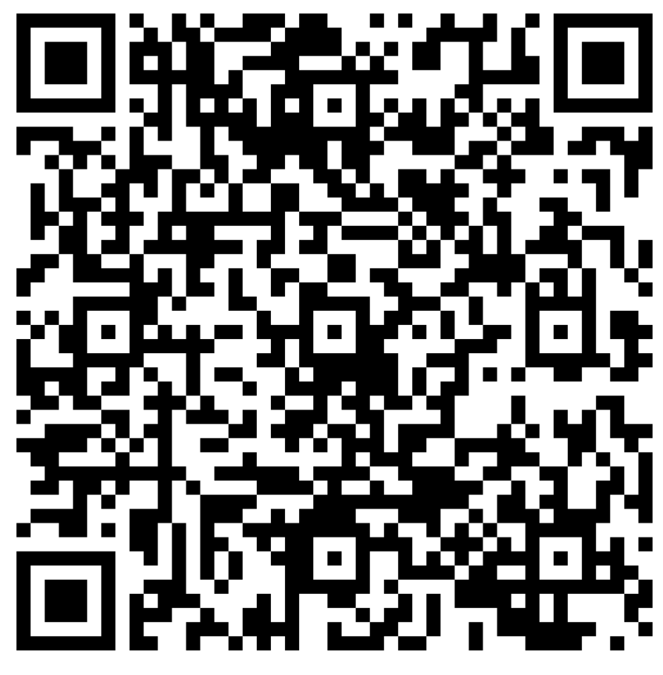
Feedback
Workshop Name: Bootcamp Metadata

