Slide 1
Getting credit (Part III): Making your data citable
Alaina Pearce & Kyle Hallisky
Open Scholarship Bootcamp
5/12/2026

Slide 2
Why Share your Data?
Advance Rigorous & Reproducible Research
Enable validation of research results
Make high-value datasets accessible
Accelerate future research directions
Increase opportunities for citation and collaboration

Slide 3
Why Share your Data?
Advance Rigorous & Reproducible Research
Enable validation of research results
Make high-value datasets accessible
Accelerate future research directions
Increase opportunities for citation and collaboration
Promote Public Trust
Foster transparency and accountability
Demonstrate stewardship over taxpayer funds
Maximize research participants’ contributions
Support appropriate protections of research participants’ data

Slide 4
Why Share your Data?
Advance Rigorous & Reproducible Research
Enable validation of research results
Make high-value datasets accessible
Accelerate future research directions
Increase opportunities for citation and collaboration
You Are May Be required to
(it is terms & conditions of your award)
Promote Public Trust
Foster transparency and accountability
Demonstrate stewardship over taxpayer funds
Maximize research participants’ contributions
Support appropriate protections of research participants’ data

Slide 5
NIH Data Management & Sharing Policy
Effective Date: January 25, 2024
Requirements:
Submission of a Data Management & Sharing Plan (DMSP) for ALL NIH-funded research that generates scientific data
Expects researchers to ‘maximize appropriate data sharing’ in established repositories
Sharing should occur no later than publication or end of award
Requires researchers to justify any sharing exceptions (i.e., ethical, legal, technical factors
Allows research to request funding for personnel costs or other fees related to data management and share actives, but the money must be spent during the grant’s award period

Slide 6
NIH Data Management & Sharing Policy
Effective Date: January 25, 2024
Requirements:
Submission of a Data Management & Sharing Plan (DMSP) for ALL NIH-funded research that generates scientific data
Expects researchers to ‘maximize appropriate data sharing’ in established repositories
Sharing should occur no later than publication or end of award
Requires researchers to justify any sharing exceptions (i.e., ethical, legal, technical factors
Allows research to request funding for personnel costs or other fees related to data management and share actives, but the money must be spent during the grant’s award period
Approved DMSPs become a term and condition of ward and non-compliance could impact future funding decisions

Slide 7
NIH Data Management & Sharing Policy
What is scientific data?
In Scope
“recorded factual material…of sufficient quality to validate and replicate research findings, regardless of whether the data are used to support scholarly publications”
Out of Scope
Lab notebooks, preliminary analyses, case report forms, physical objets, drafts of scientific papers, plans for future research, peer reviews

Slide 8
NIH Data Management & Sharing Policy
What is scientific data?
In Scope
“recorded factual material…of sufficient quality to validate and replicate research findings, regardless of whether the data are used to support scholarly publications”
Out of Scope
Lab notebooks, preliminary analyses, case report forms, physical objets, drafts of scientific papers, plans for future research, peer reviews
When Limit to Sharing - Justifiable ethical, legal, and technical factors:
Informed consent will not permit or limits scope of sharing or use
Privacy or safety of research participants would be compromised and available protections insufficient
Explicit federal, state, local, or Tribal law, regulation, or policy prohibits disclosure
Restrictions imposed by existing or anticipated agreements with other parties

Slide 9
NIH vs Draft NSF DMSP
 | NIH | NSF (Draft)
What must be shared? | Scientific data: “Recorded factual material…of sufficient quality to validate and replicate research findings, regardless of whether the data are used to support scholarly publications” | •Primary data •Samples •Physical collections •Scripts/code •Curriculum material •Other supporting materials created or gathered during award period
Timeline | •At publication •End of Award (even if not supporting published finding) | At publication
Page Limit | NEW 5/25/26 | Must use NSF webform (no page limit)
Required Elements | •4 questions with Yes/No checkbox •Additional justification for any No responses •Table: each data type and repository for sharing | •Data and Research Product Categories •Access Policies and Limitations •Data Standards and Metadata •Data Provenance •Public Archiving •Retention Time •Accountability
Repository Requirements | Encourages use of established repositories | Must provide a persistent identifier (e.g., DOI)

Slide 10
Repositories
Domain Specific
Institutional
Generalist
Set up to accommodate data needs of a specific research community
Will have specialized metadata fields
May adopt a field standard
May use standardized vocabulary/ontology
Support and promote research outputs of an institution
Will accept various data types and formats across disciplines
May provide curation services/deposit assistance
Accept data regardless of type, format, content, or disciplinary focus
Will have fewer/less specialized metadata
Likely will not provide curation/deposit assistance
Notes:
Desired features:
Provides a persistent identifier
Provides your work a landing page with metadata
Matches your needs (e.g., formats accepted, access, back-up and recovery, etc.)
Platform is sustainable and provides longevity of service
Clear terms and conditions
Curation support
Provides guidance on how to cite the data
Tracks how the data has been used by providing access and download statistics
Limited to no cost

Slide 11








Repositories
Domain Specific
Institutional
Generalist
Notes:
Desired features:
Provides a persistent identifier
Provides your work a landing page with metadata
Matches your needs (e.g., formats accepted, access, back-up and recovery, etc.)
Platform is sustainable and provides longevity of service
Clear terms and conditions
Curation support
Provides guidance on how to cite the data
Tracks how the data has been used by providing access and download statistics
Limited to no cost

Slide 12
Repositories
Open Access
Controlled/Mediated Access
Closed
Metadata is fully discoverable
Data are accessible
Data can be downloaded immediately
Data access is mediated
Good for level 1 data
Good for identifiable/highly sensitive data
Notes:
Desired features:
Provides a persistent identifier
Provides your work a landing page with metadata
Matches your needs (e.g., formats accepted, access, back-up and recovery, etc.)
Platform is sustainable and provides longevity of service
Clear terms and conditions
Curation support
Provides guidance on how to cite the data
Tracks how the data has been used by providing access and download statistics
Limited to no cost

Slide 13
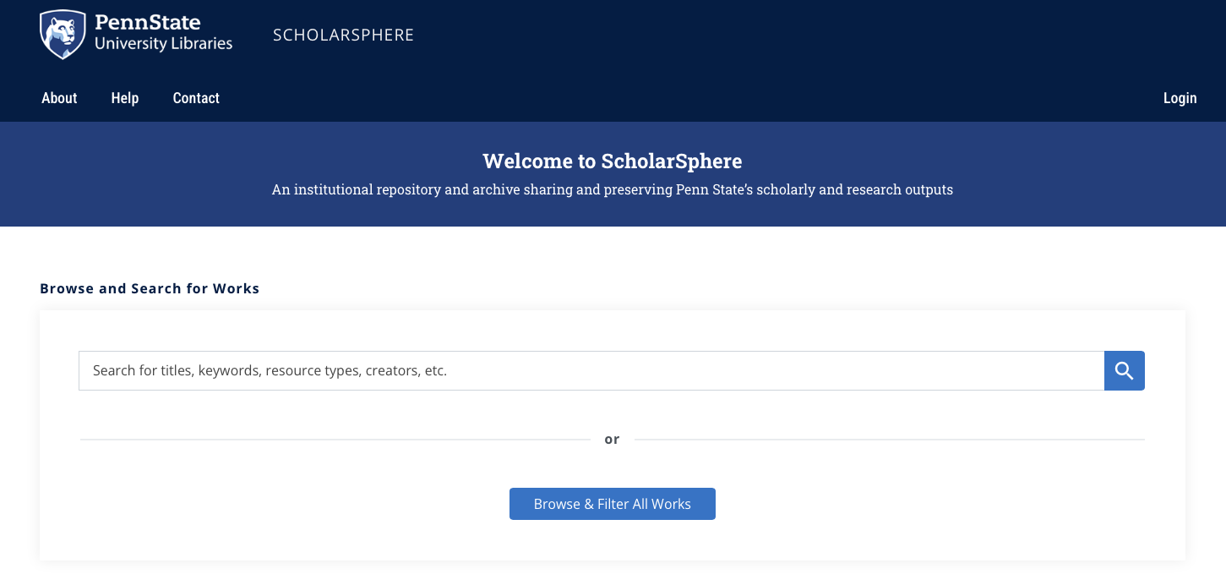
Institutional Tools & Resources
ScholarSphere
scholarsphere.psu.edu
Notes:
Self-deposit for PSU faculty, staff, and students at no cost
Supports data sharing requirements and “F.A.I.R” principles
Findable. Accessible. Interoperable. Reusable.
Satisfies requirements of PSU Open Access Policy (AC02)
Work drafts and versioning
Flexible access and visibility controls
Persistent access and preservation of work through DOI minting​
Monthly reports tracking download statistics
Curation services from PSU Librarians and the Data Curation Network​

Slide 14
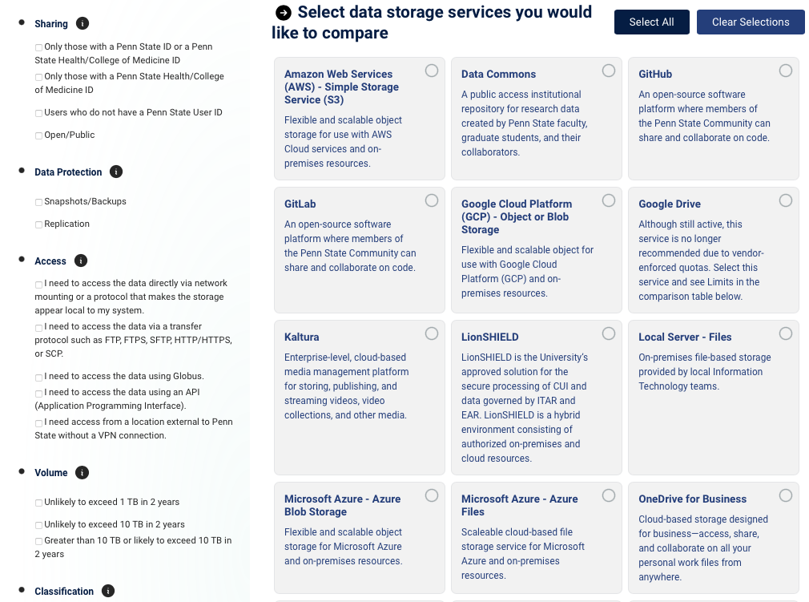
Institutional Tools & Resources
Penn State Data Storage Finder
datastoragefinder.psu.edu

Slide 15
Get credit for the time & effort

Slide 16

What is a Data paper?
Peer-reviewed article with the primary goal of describing a data set
Describe the context and provenance of data
Highlights the value and utility of data for others
Explains the who, what, where, when, why, and how of the data

Slide 17
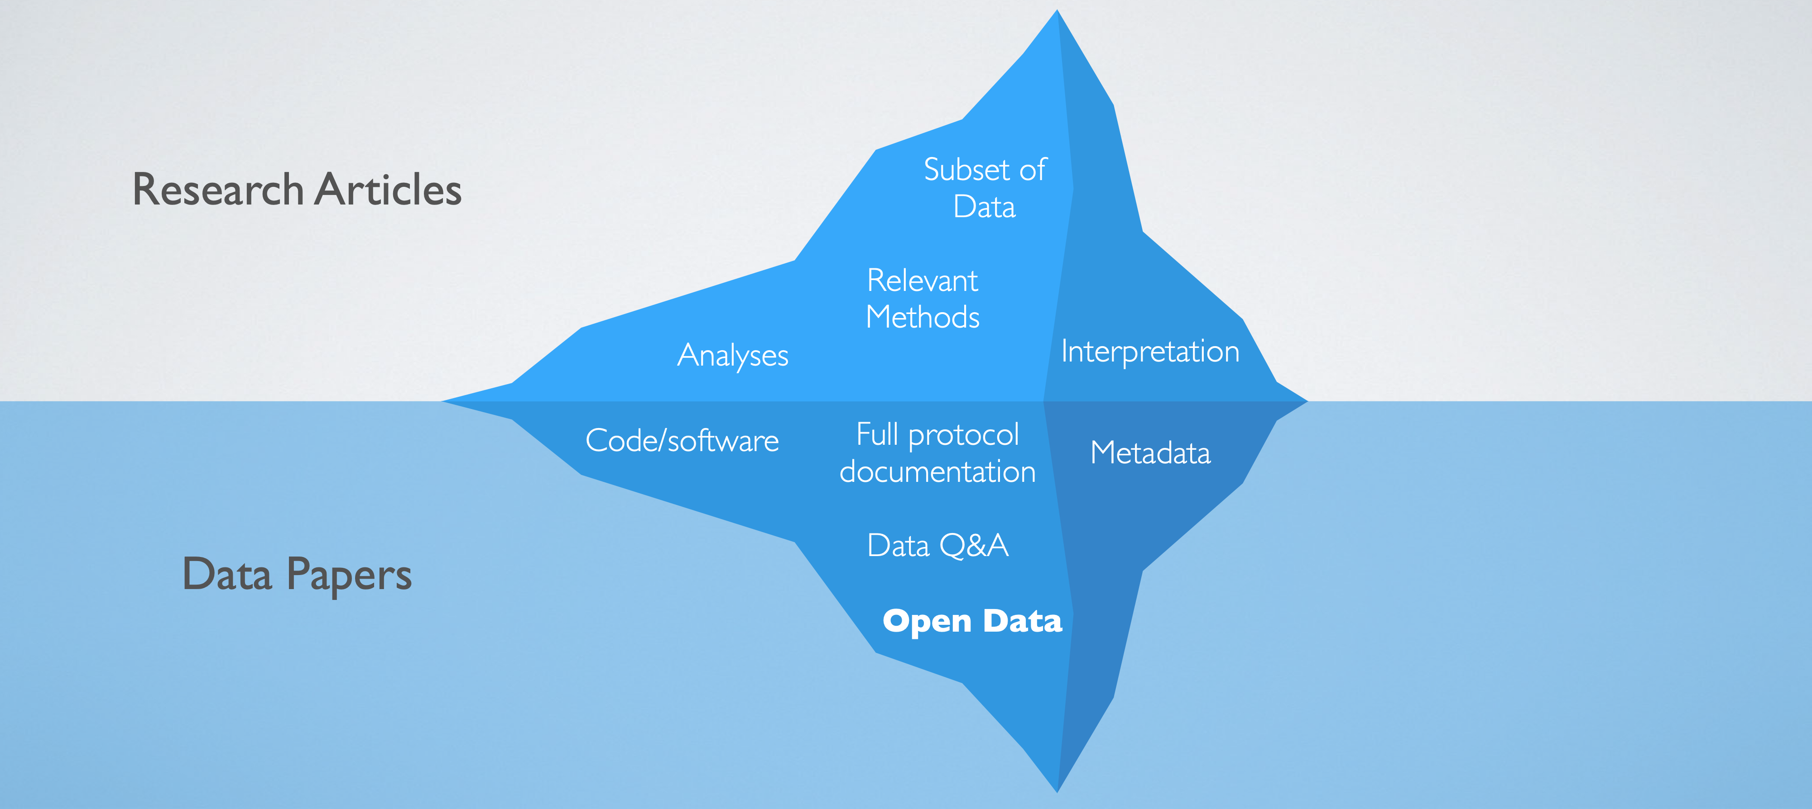
Data & Research paper ecosystem

Slide 18
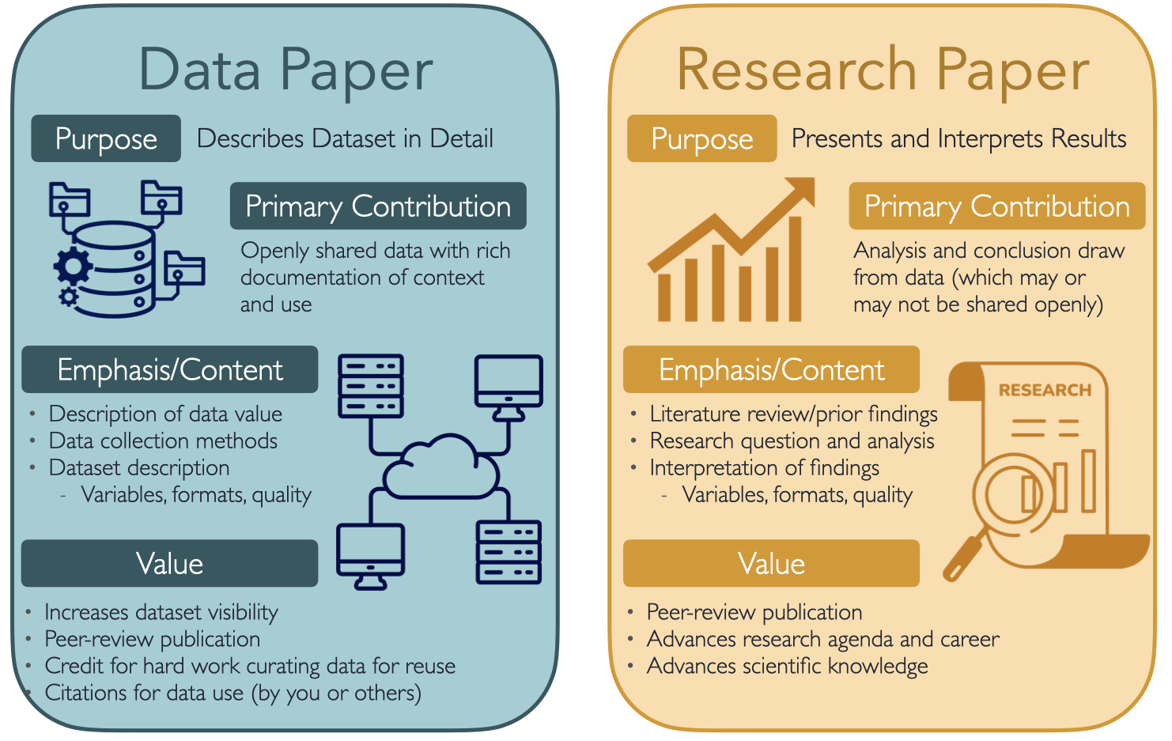

Slide 19
Data & Research paper ecosystem
Research paper
Cites data paper in data availability statement
Points to project directory to support open methods
Project Repository
Dataset
Open protocol and documentation
Version control/change log to maintain record of changes
Provides necessary context for data
All raw data files in open formats
Associated metadata
Often in a data repository separate from the project repository
Data paper
Provides full documentation of dataset
Project repository and dataset subject to peer review to ensure usability

Slide 20

Structure of a Data paper
Introduction:
Often very brief - introductions can be as short as a 1-2 paragraphs
Goals:
Describe the purpose the dataset
Describe relevant societal and/or scientific value:
Why is data need?
What value does it provide beyond your primary research paper?
DATA

Slide 21
Structure of a Data paper
Introduction:
Often very brief - introductions can be as short as a 1-2 paragraphs
Goals:
Describe the purpose the dataset
Describe relevant societal and/or scientific value:
Why is data need?
What value does it provide beyond your primary research paper?
DATA
Related Resources:
Associated publications (e.g., research papers using the data)
Companion project and/or code repositories

Slide 22

Structure of a Data paper
Methods:
Study design - observational, experimental, etc
Ethical approvals
Protocol
Data collection - dates, locations, equipment used, etc.
Variables measured and rational
Data processing
Steps taken to clean data - want to share ‘raw’ usable data
Quality control procedures
Software/code used

Slide 23

Structure of a Data paper
Data Description:
Data access - repository name, DOI, license, and access conditions
Overview
General description of dataset including number and size of files
Structure of data - directory structure and links/relationships between data files
Key variable description
Descriptive statistics about key variables (e.g., range of values, number of missing values, variance and central tendency)
Quality control metrics
Identification of low quality observations

Slide 24

Structure of a Data paper
Technical Validation:
Approach to testing data quality (e.g., accuracy and consistency)
Quality control protocols
Validation of data (cross-checks, error analysis)
Protocols to ensure quality data (e.g., randomization, blinding, etc)
Phenotypic or genotypic assessments of biological samples (e.g., confirmation of cell line or disease status)
Known systemic issues or limitations

Slide 25

Structure of a Data paper
Discusion/Conclusions:
Describe the data’s unique value
Unique elements for field related to size and/or sample, resolution, etc.
Diversity of measures
Expensive measures
Describe how the data fills a gap if one exists
Describe how the data can be applied and/or reused
Interdisciplinary uses
Possible research questions (unrelated/not answered by primary grant)
Describe limitations or potential pitfalls for users
Warnings about out-of-scope analyses/uses
Guidance/recommendations

Slide 26
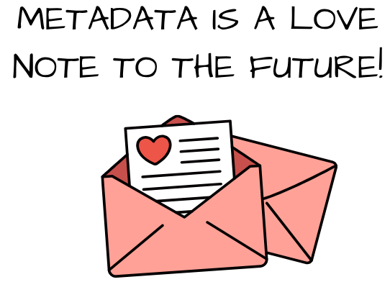
Open Data and Metadata
Not enough to just post/share data - it needs to be documented
Metadata is highly structured data laid out in fields, often with controlled vocabularies
the who, what, when, where, and why of data
*slides and resources from yesterday on website*

Slide 27
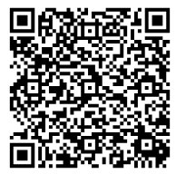
Institutional Tools & Resources
Research Data Stewardship Program
Free Consultations:
Data Visualization
Data Sharing
Statistical Results Interpretation
Data Analysis Planning
Code & Software Troubleshooting
Research Data Management
Data Management and Sharing Plans
Bookings Page

Slide 28
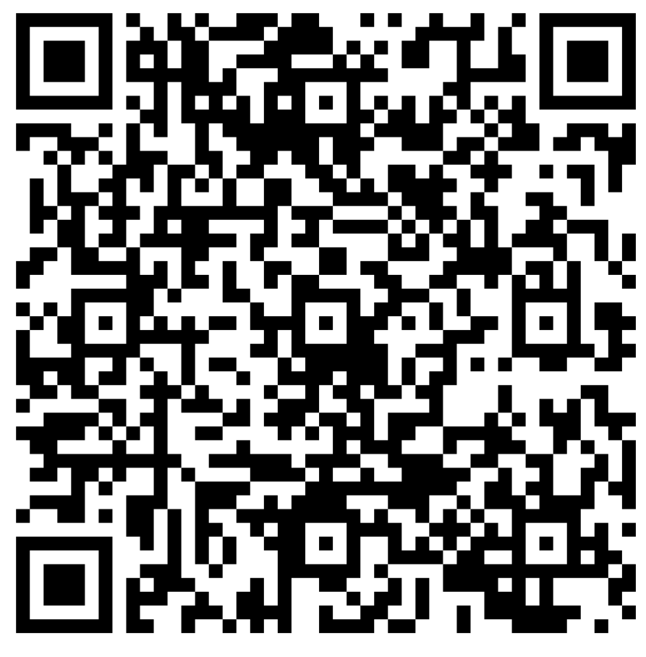
Feedback
Workshop Name: Bootcamp Data & Data Papers

