Slide 1
Harnessing advanced cyberinfrastructure for research
An introduction to Roar and ICDS resources
Carrie Brown – carrie.brown@psu.edu
Institute for Computational and Data Sciences
Client Support Lead

Slide 2
Today’s Agenda
Introduction to HPC
Running Jobs
Advanced Slurm Options
Data Storage and Transfer
Software

Slide 3
Introduction to HPC

Slide 4
What is High Performance Computing?
High Performance Computing most generally refers to the practice of aggregating computing power
in a way that delivers much higher performance
than one could get out of a typical desktop computer or workstation
in order to solve large problems in science, engineering, or business.
https://insidehpc.com/hpc-basic-training/what-is-hpc/

Slide 5
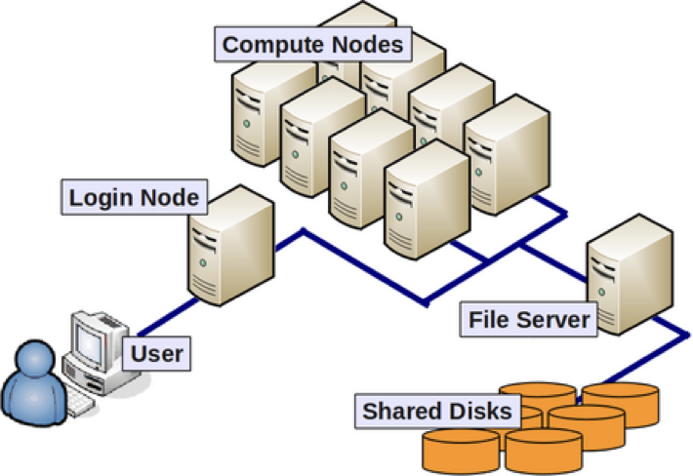
Submit Node
Filesystem
Image Source: https://wvuhpc.github.io/Introduction-HPC/101-introduction/index.html

Slide 6
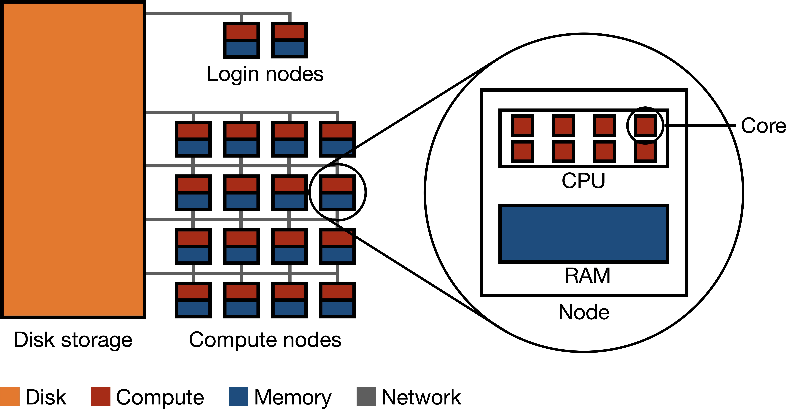
Submit Nodes
CPU
Image Source:
https://ekatsevi.github.io/statistical-computing/hpc-basics.html

Slide 7
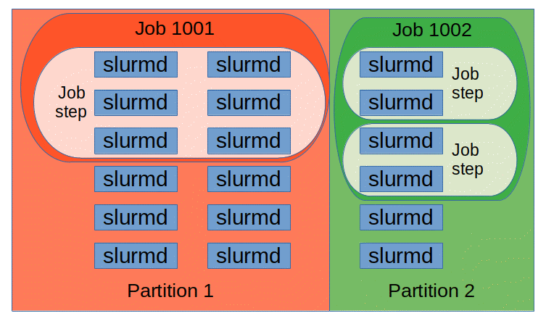
Image Source: https://slurm.schedmd.com/quickstart.html

Slide 8
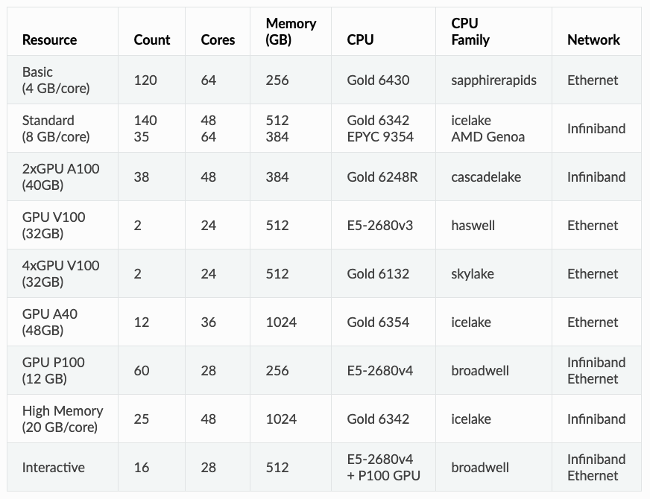
Roar Collab Hardware Specifications
400 nodes
20,000 cores
150+ GPUS
~13 PiB
data storage

Slide 9
Partitions on Roar Collab
Partition name | Used For | Memory Per Core | Interconnect | Note
interactive | Jobs requiring graphical support such GUIs and 3D modeling. | 4 GB/core | N/A | Limited to a single job per user with a maximum of 4 cores, 64 GB memory, and 48 hours runtime
basic | Independent, small jobs that will not need more than a single node of resources | 4 GB/core | Ethernet
standard | Moderate memory jobs, multi-node/MPI jobs, GPU-enabled jobs | 8 GB/core | Infiniband | GPUs only available in “standard” partition
himem | Jobs with high memory needs | 20 GB/core | Infiniband
sla-prio | Hardware reserved for paid allocation owners | Variable | Variable | Resources dependent on SLA

Slide 10
Running Jobs

Slide 11
Portal
portal.hpc.psu.edu
file manager
Filesystem
interactive desktop/apps
https
Interactive Session
salloc
Submit Nodes
submit.hpc.psu.edu
User
ssh
sbatch
scp
sftp
sbatch
Batch Session
Compute Nodes
Roar Collab User Flow Diagram

Slide 12
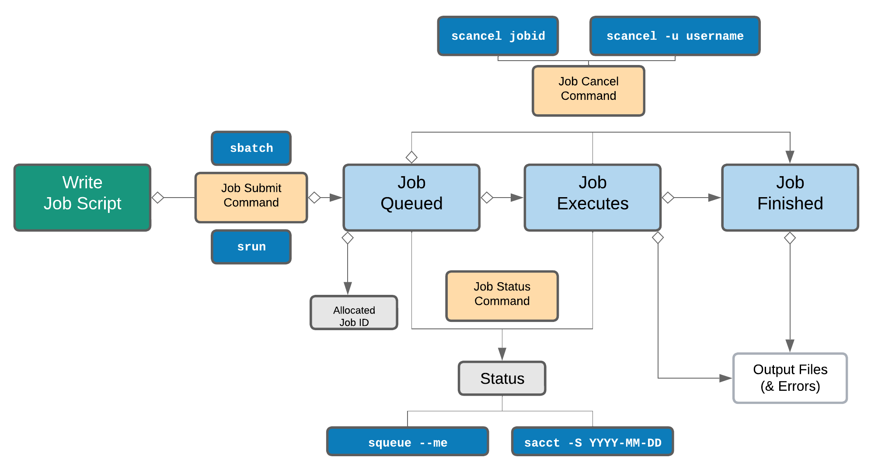
Workflow
Batch Jobs
salloc
Image Source: https://genomicsaotearoa.github.io/metagenomics_summer_school/day1/ex2_1_intro_to_scheduler/#life-cycle-of-a-slurm-job

Slide 13
Slurm Batch Script Example
#!/bin/bash
#SBATCH --nodes=1
#SBATCH --ntasks-per-node=1
#SBATCH --time=10:00
#SBATCH --mem=10gb
#SBATCH --partition=standard
#SBATCH --account=open
#SBATCH --output=R-normalize.%j.out
#SBATCH --error=R-normalize.%j.err
# Load R
module purge
module load r/4.4.0
# Run the job itself
Rscript normalize.R
Header
Shebang
Scheduler Directives
Additional example scripts can be found at:
https://github.com/PSU-ICDS/rc-example-jobs
Body / Job Payload
Commands to be executed

Slide 14
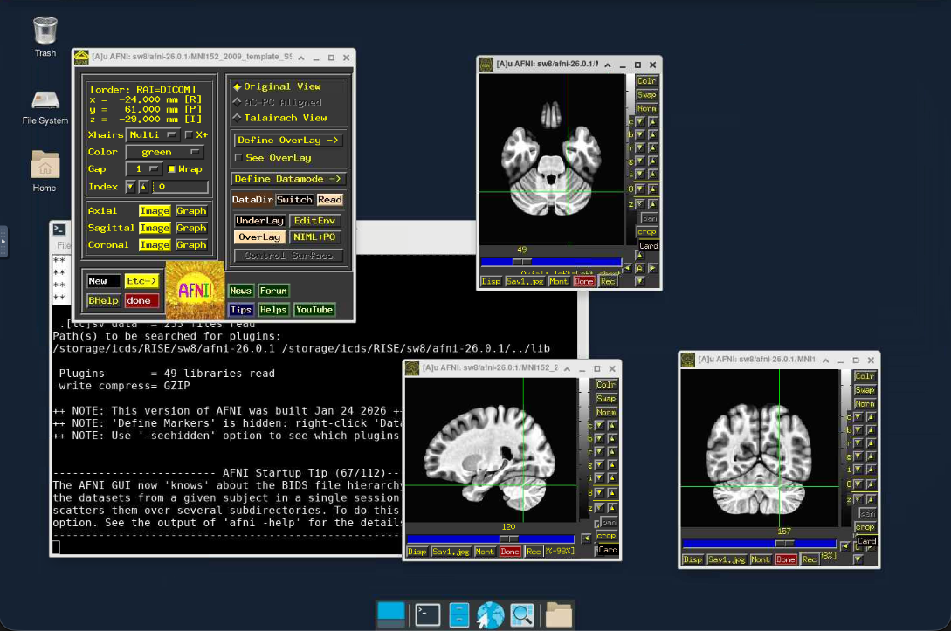
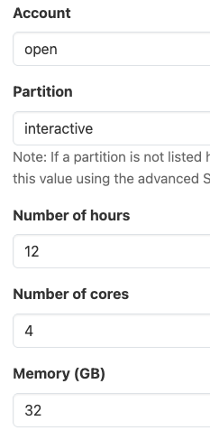
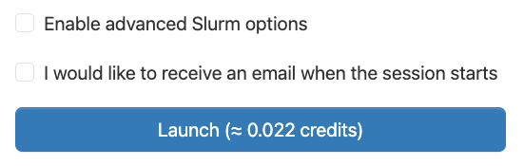
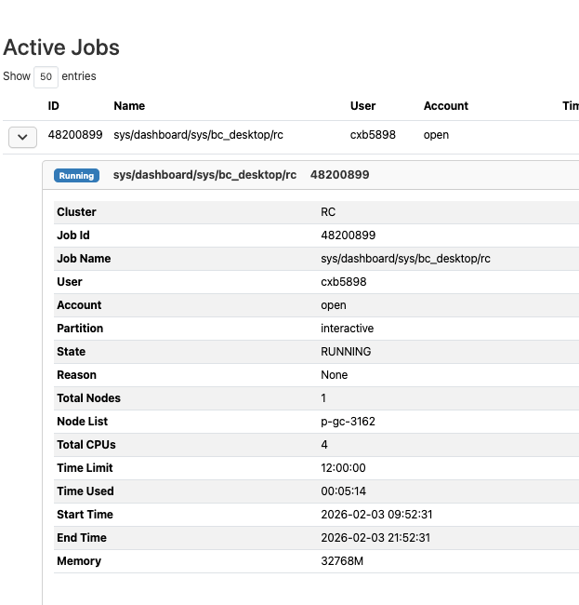


Workflow
Portal Jobs
salloc
Image Source: https://genomicsaotearoa.github.io/metagenomics_summer_school/day1/ex2_1_intro_to_scheduler/#life-cycle-of-a-slurm-job

Slide 15
Provisioning Resources in Slurm
Defaults:
open account
basic partition
24 hours
1 task (core)
4 GB memory
Long Directive | Short directive
--account=open | -A open
--partition=basic | -p basic
--time=24:00:00 | -t 24:00:00
--ntasks=1 | -n 1
--mem=4GB

Slide 16
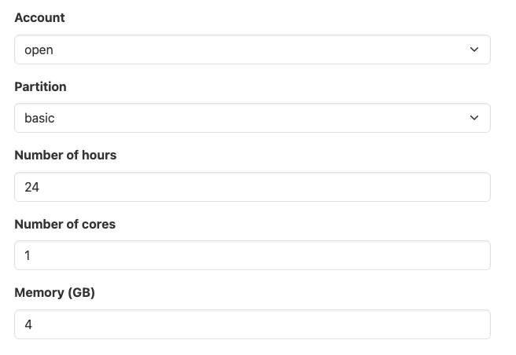
Provisioning Resources in Slurm
Defaults:
open account
basic partition
24 hours
1 task/core
4 GB memory

Slide 17
Common Resource Directives
Directive | Description
-J or --job-name | Specify a name for the job
-A or --account | Account to charge resource usage against
-p or --partition | Request a specific partition
-N or --nodes | Number of nodes for the job
-n or --ntasks | Number of tasks total
--ntasks-per-node | Number of tasks per node
--mem or --mem-per-cpu | Specify the memory required per node or CPU
-t or --time | Set a limit on the total run time of the job
-e or --error | Direct standard error to a non-default file
-o or --output | Direct standard output to a non-default file
--cpus-per-task | Number of cores per task
--mail-user | Email to send notification to
--mail-type | When to be notified (common ones are BEGIN, END, FAIL, ALL)
--gres (ex: –gres=gpu:a100:1) | Additional allocated resources (such as GPUs)

Slide 18
Quiz: How many resources are allocated for each one here
--nodes=1
--ntasks=20
--mem=100GB
--nodes=2
--ntasks-per-node=4
--cpus-per-task=4
--mem-per-cpu=10GB
--ntasks=48
--mem-per-cpu=10GB
--nodes=4
--ntasks-per-node=20
--mem-per-cpu=10GB
Total Cores | 48
Total Memory | 480 GB
Nodes | Variable
Cores per Node | Variable
Total Cores | 20
Total Memory | 100 GB
Nodes | 1
Cores per Node | 20
Total Cores | 80
Total Memory | 800 GB
Nodes | 4
Cores per Node | 20
Total Cores | 32 (4 x 4 x 2)
Total Memory | 320 GB
Nodes | 2
Cores per Node | 16 (4 x 4)

Slide 19
Quiz: How many resources are allocated for each one here
--nodes=1
--ntasks=20
--mem=100GB
--nodes=2
--ntasks-per-node=4
--cpus-per-task=4
--mem-per-cpu=10GB
--ntasks=48
--mem-per-cpu=10GB
--nodes=4
--ntasks-per-node=20
--mem-per-cpu=10GB
Total Cores | 48
Total Memory | 480 GB
Nodes | Variable
Cores per Node | Variable
Total Cores | 20
Total Memory | 100 GB
Nodes | 1
Cores per Node | 20
Total Cores | 80 (20 x 4)
Total Memory | 800 GB
Nodes | 4
Cores per Node | 20
Total Cores | 32 (4 x 4 x 2)
Total Memory | 320 GB
Nodes | 2
Cores per Node | 16

Slide 20
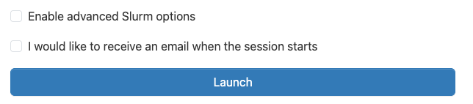
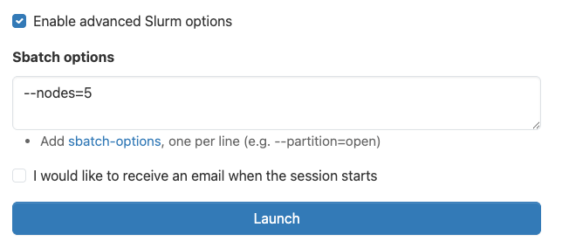
Custom Resource Requests on the Portal
Any directives in the ”Sbatch options” box override those in the form.

Slide 21
Provisioning Resources in Slurm
Defaults:
open account
basic partition
24 hours
1 task/core
4 GB memory
1 node
--account
--partition
--time
Be careful of interactions with advanced Slurm directives!
--cpus-per-task
--mem

Slide 22
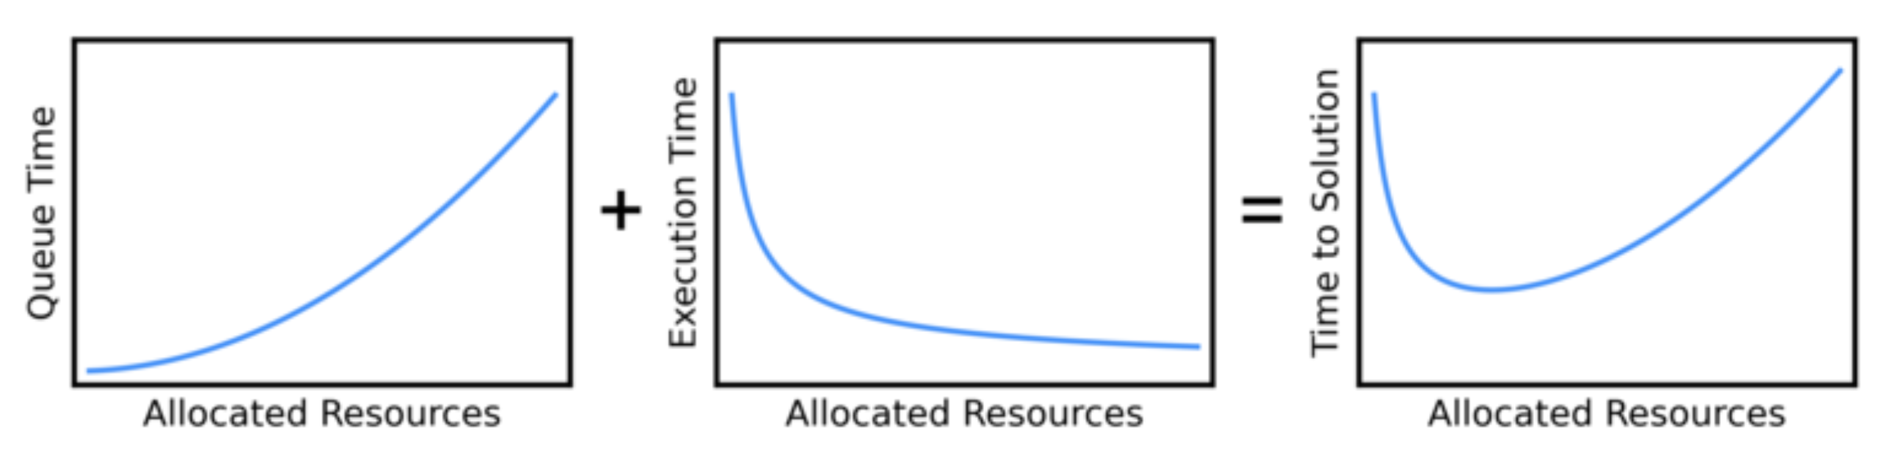
Requesting Resources
https://researchcomputing.princeton.edu/support/knowledge-base/scaling-analysis
Start small – example or test data set
Monitor resource use
Benchmark large jobs
”Turn off” idle jobs

Slide 23
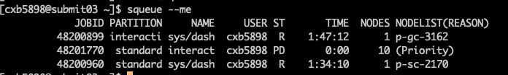
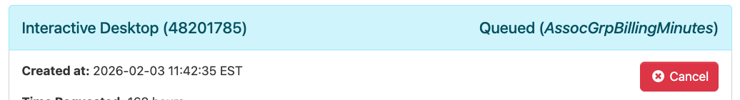
Monitoring Jobs – Pending Jobs

Slide 24
Monitoring Jobs – Pending Jobs
Reason Code | What it means
Priority | One or more jobs with higher priority are ahead of yours in the queue
Resources | Your job is next in line and is waiting for available resources
AssocGrpBillingMinutes | Your credit account does not have sufficient balance to run this job.
QOSMaxCpuPerUserLimit or QOSMaxMemoryPerUser | Your job exceeds available allocation CPU or memory limits.
ReqNodeNotAvail, Reserved for maintenance | Your job will not complete prior to a scheduled outage and has been held

Slide 25
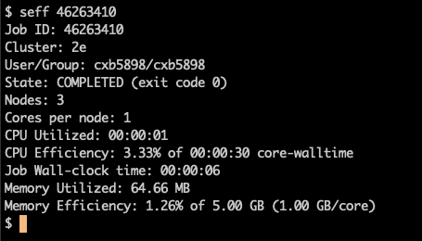
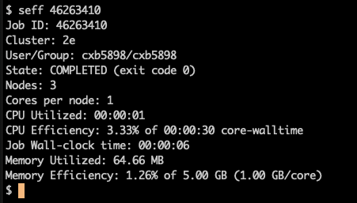
Monitoring Jobs – Resource Usage
seff provides resource usage details for completed jobs

Slide 26
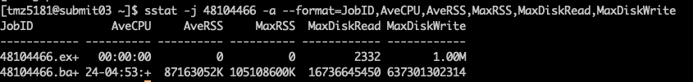
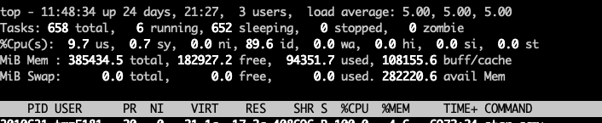
Monitoring Jobs – Running Jobs
sstat provides metrics for running jobs
Users can also ssh to nodes where they have running jobs, and use tools like top and ps to monitor processes

Slide 27
Selecting the best partition
Selecting the right hardware partition for your job is important for cost-effective, high efficiency usage
Key Considerations
Memory per core | Additional memory charges can cause a job to be more expensive on the wrong partition Consider your memory per core ratio and select the partition that meets but does not exceed it
Multi-node jobs | For jobs that use MPI, the Infiniband interconnect is important to maintain run-time efficiency
GPUs | GPUs are only available on the standard partition

Slide 28
Quality of Service (QOS)
RC has three different job QOS’s
  Standard – default
  Debug – for debugging and testing
    Usage limits: 64 cores, 512 GB, 2 nodes, 4 hours, 1 job per user
  Express – for increased priority
    Same as standard, but twice the credit cost
To use: --qos=debug or --qos=express

Slide 29
Paid Resources
Compute
Storage
Allocation:
  Immediate access to resources 24/7
  Fixed monthly cost
Credits:
  Pay only for what you use
  Access different compute configurations at will
Active Group
  Mounted to compute resources
  Shared with authorized group members
Archive
  Long term storage
  Transfer via Globus

Slide 30
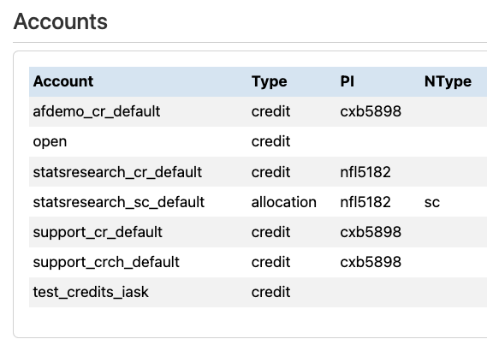
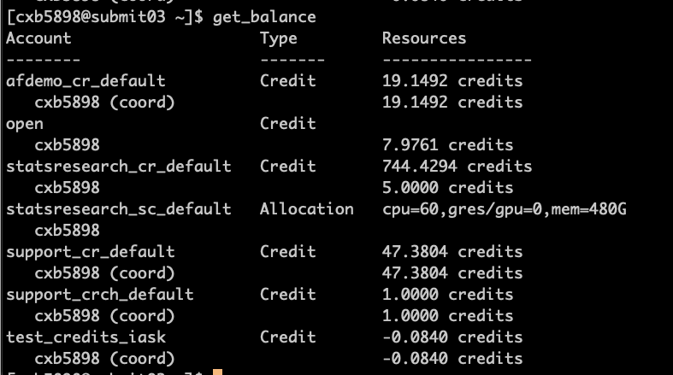
Available Accounts

Slide 31
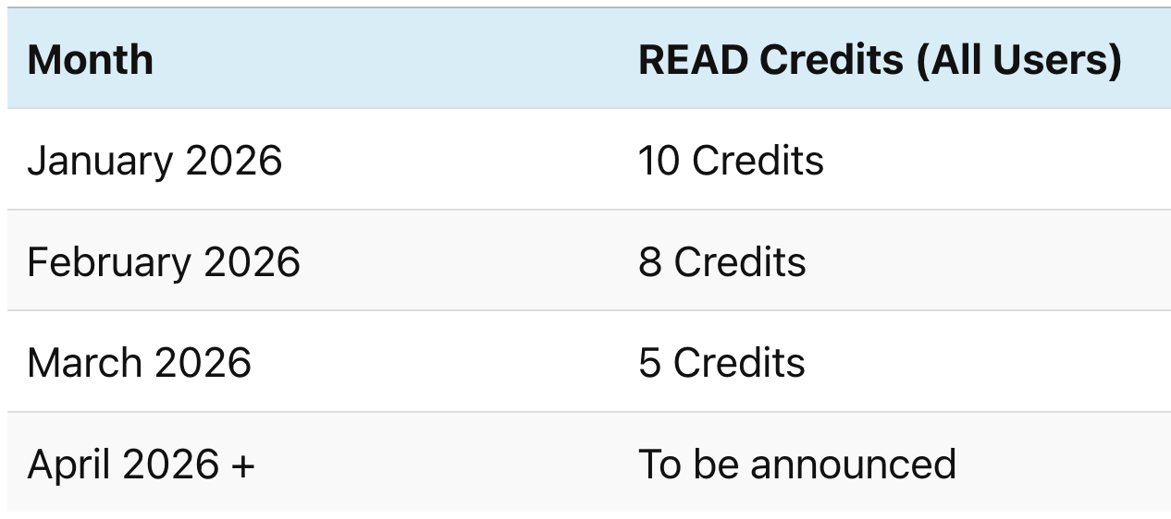
Research Exploration and Discovery (READ) credits / Open Account
As of January 2026, ICDS offers All users get a free amount of monthly READ credits that can be used through the “open” account
Additional credits available via purchase, applying for additional READ credits, or through your College or Department.

Slide 32
Advanced Slurm Options

Slide 33
Filename Pattern Symbols
Symbol | Description
%j​ | Job ID
%x | Job name
%u​ | Username​
%N​ | Hostname where the job is running
%A | Job array's master job allocation number
%a | Job array ID (index) number
Both standard output and standard error are directed to the same file by default, and the file name is "slurm-%j.out", where the "%j" is replaced by the job ID.
The output and error filenames are customizable, however.
For example:
#SBATCH --output=%x-%j.out
#SBATCH --error=%x-%j.err

Slide 34
Environment Variables
Environment Variable | Description
SLURM_JOB_ID | batch job id assigned by Slurm
SLURM_JOB_NAME | user-assigned job name
SLURM_NNODES | number of nodes
SLURM_NODELIST | list of nodes
SLURM_NTASKS | total number of tasks
SLURM_QUEUE | queue (partition)
SLURM_SUBMIT_DIR | directory of submission
SLURM_NTASKS_PER_NODE | number of tasks per node
SLURM_ARRAY_TASK_ID | array index value
Can be used in the command section of a submit file (passed to scripts or programs via arguments)
Cannot be used within an #SBATCH directive
  Use Replacement Symbols instead

Slide 35
Advanced Slurm: Job Arrays
Submits a specified number of identical jobs with individual id values
Usage: #SBATCH --array=<array numbers or ranges>
To cancel array jobs: scancel <job_id>_<array_id(s)>
  Example: $ scancel 73455_1
Example:
  #SBATCH –array=1:10
    Submits 10 identical jobs with $SLURM_ARRAY_TASK_ID values from 1 to 10
  #SBATCH --array=1,3,5
    Submits 3 identical jobs with $SLURM_ARRAY_TASK_ID values 1, 3, and 5

Slide 36
Advanced Slurm: Dependencies
Queues jobs that depend on the completion of previous job(s)
Usage: --dependency=<when_to_execute>:<job_id>
  After successful completion --afterok:<job_id>
  After non-successful completion --afternotok:<job_id>
Example: execute after successful completion of job_id=73455
  --dependency=afterok:73455

Slide 37
Data Storage and Transfer

Slide 38
Data Storage on Roar Collab
Users can access personal storage locations and shared group storage locations from any node.
NOTE: Scratch has a brief grace period for size quota to prevent interrupting running jobs.
Storage | Location | Quota | Backup Policy | Use Case
Home | /storage/home | 16 GB 500,000 files | Daily Snapshot | Configuration files
Work | /storage/work | 128 GB 1 million files | Daily Snapshot | Primary user-level data storage
Scratch | /scratch | 50 TB 1 million files | No backup Files purged after 30 days | Temporary, unimportant files
Temp | /tmp | Limited to available space on the node | None Files removed once job ends | Job specific temporary storage for I/O sensitive workflows
Group | /storage/group | Allocation-dependent | Daily Snapshot | Primary storage for shared data

Slide 39
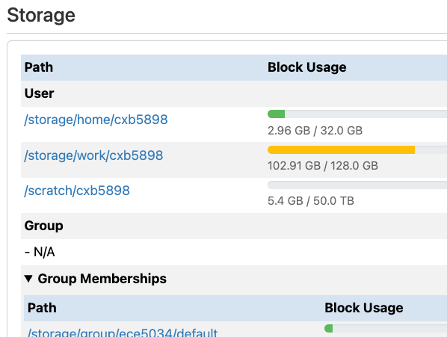
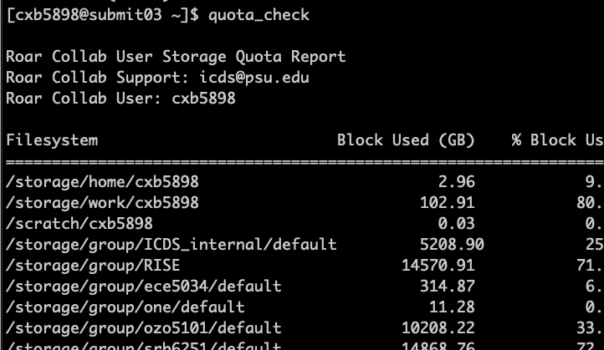
Available Storage

Slide 40
Transferring Files - Portal
File App
  Allows for basic file manipulation and small file transfer
  (> 1 GB recommended)
  Link to Globus
Interactive Desktop or other Apps
  Web browser or command line utilities

Slide 41
Transferring Files - CLI
Secure Copy (scp) - Ideal for single files/archives
  scp user@host:source_file user@host:target_file
  Example:
scp my_file.txt abc123@submit.hpc.psu.edu.edu:$WORK/my_file.txt
Remote Sync (rsync) - Ideal for more complicated data transfers
  rsync source_files user@host:target_file
  Example:
rsync –av my_directory abc1234@submit.hpc.psu.edu:$WORK/my_directory

Slide 42
Transferring Files - Other Tools
SCP client
  WinSCP (http://winscp.net) – Windows
  Cyberduck (http://cyberduck.io) – MacOS
  Filezilla (http://filezilla-project.org) – Windows, MacOS and Linux
Globus Connect (http://globus.org)

Slide 43

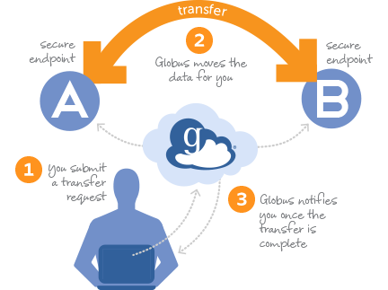
www.globus.org
A robust file transfer and sharing platform
Transfer data between established endpoints using web-based GUI or CLI tools
Share data easily with anyone who has a GlobusID (uses CILogon)
SharePoint and AWS connectors available

Slide 44
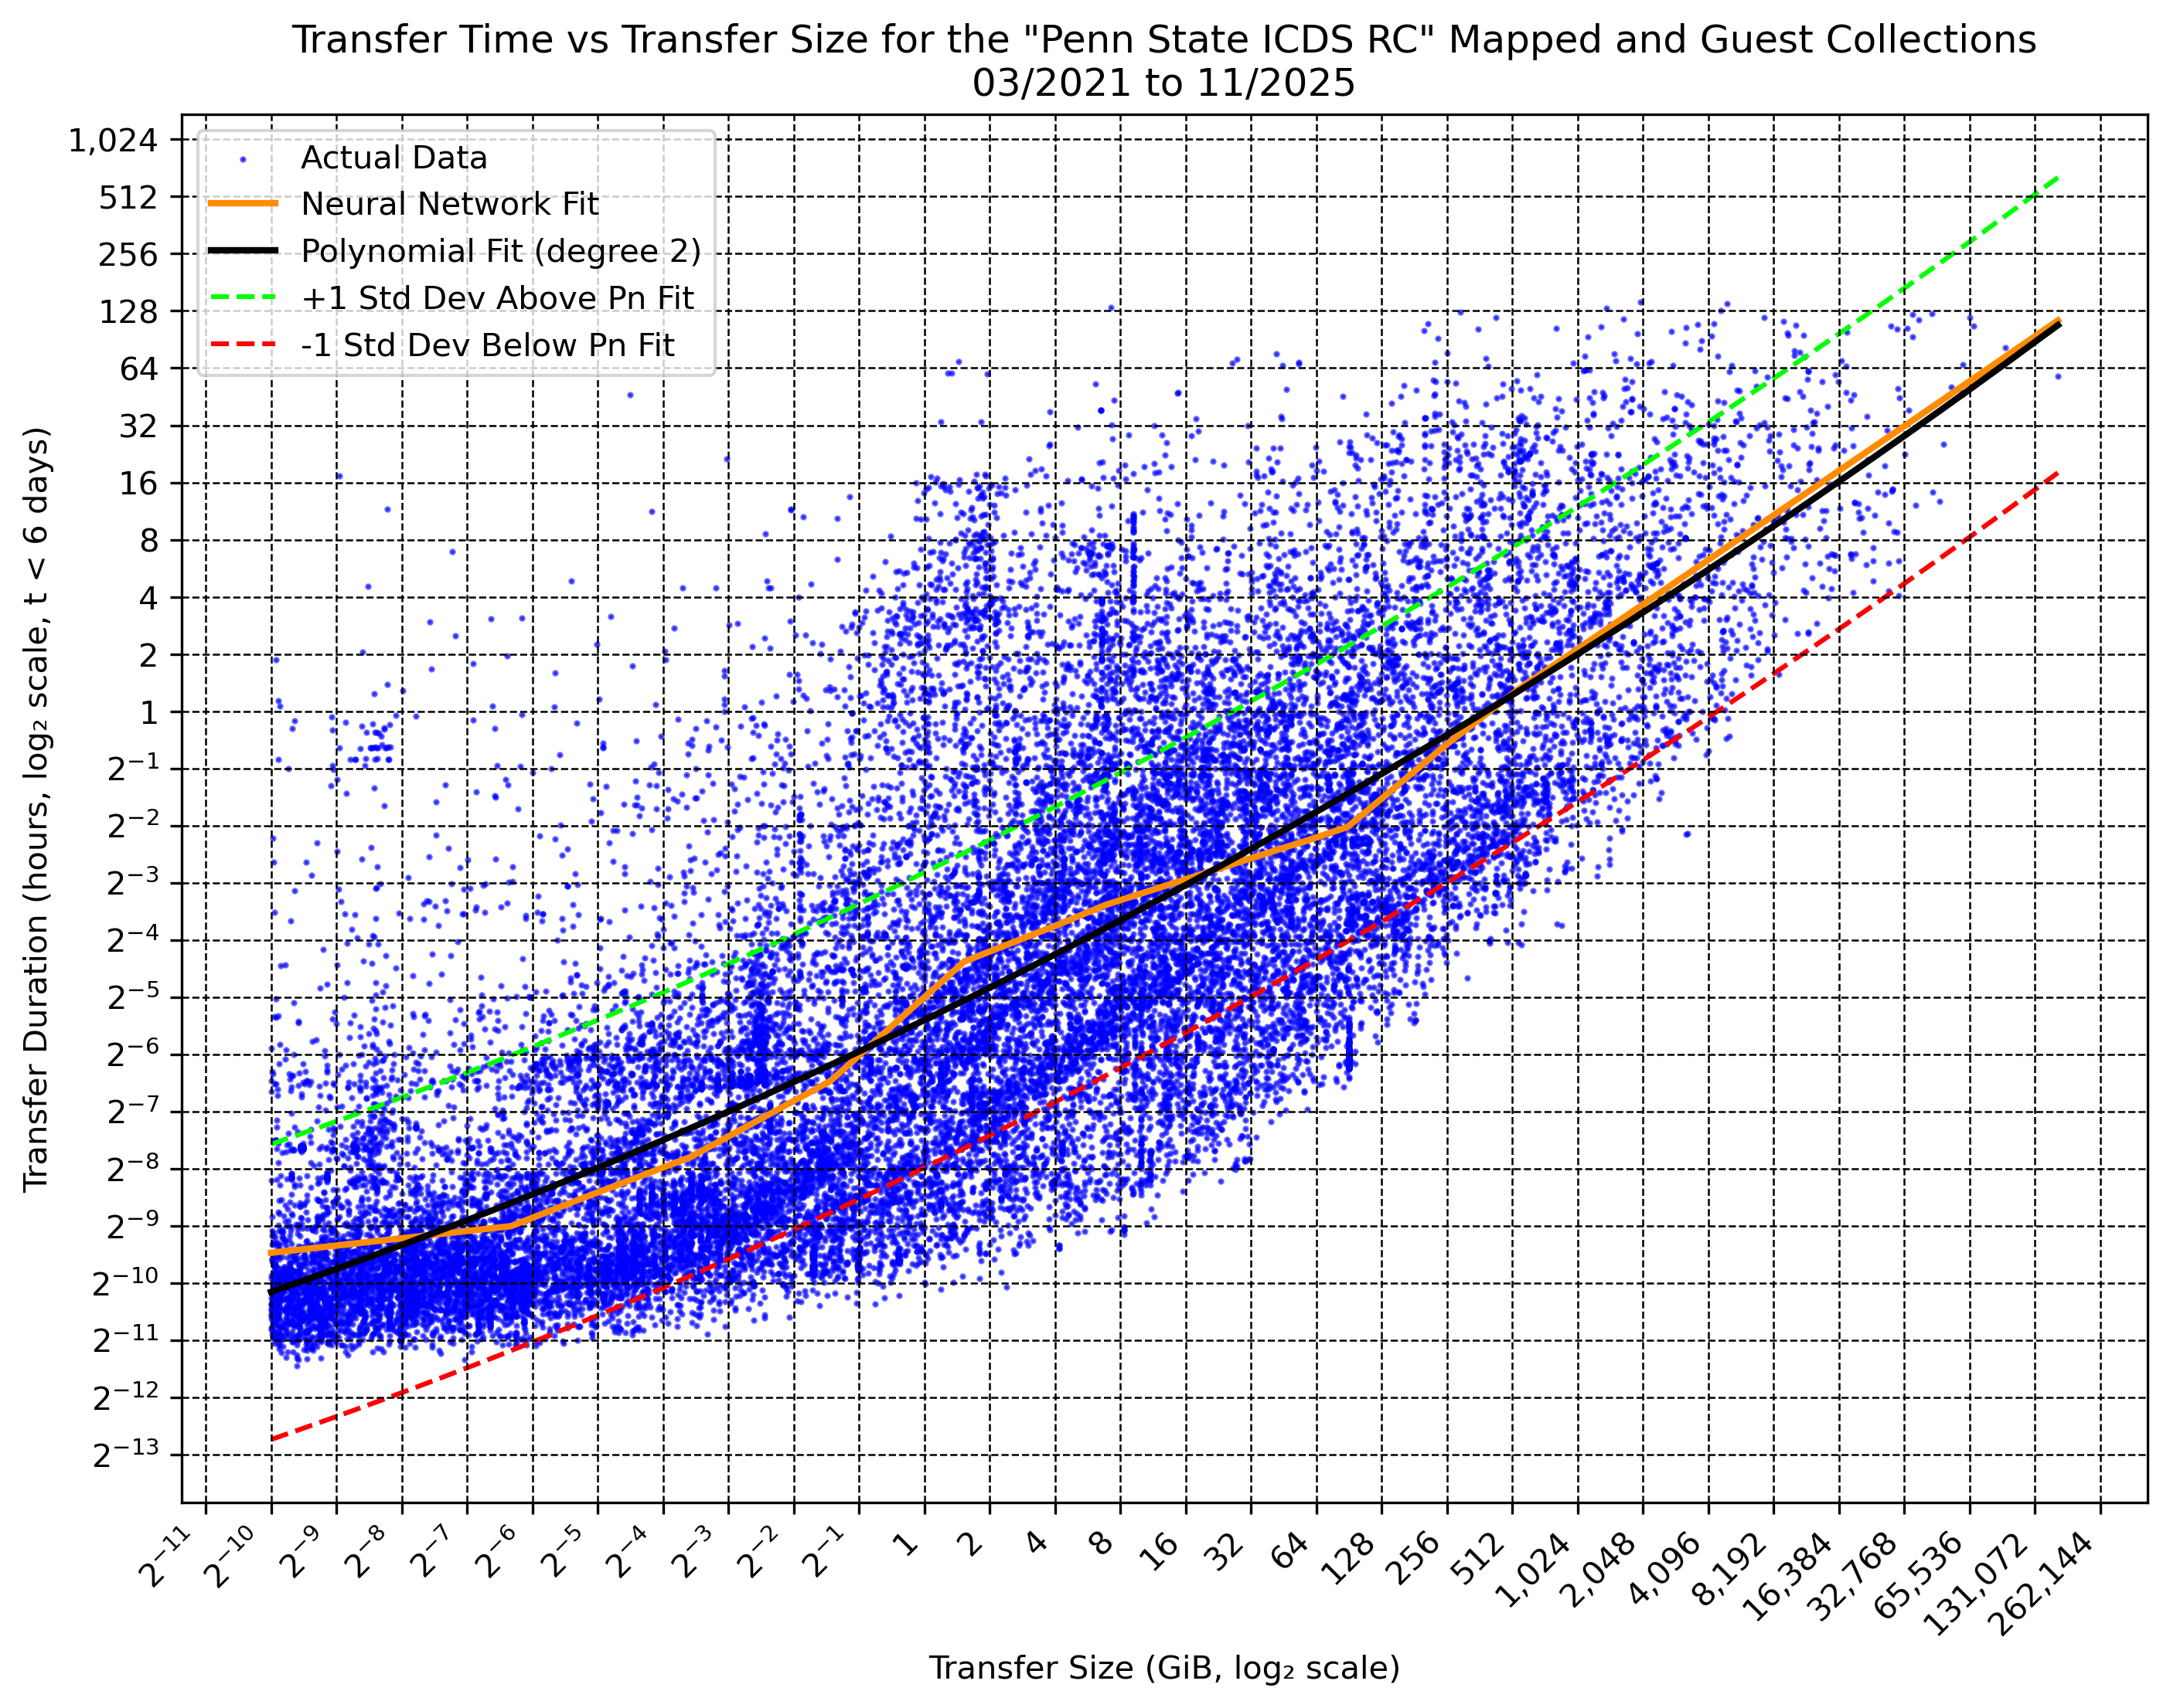
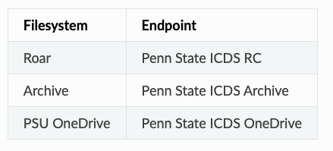
Globus:
ICDS Endpoints
Globus documentation: https://docs.globus.org/guides/tutorials/manage-files/transfer-files/
ICDS User Gude: https://docs.icds.psu.edu/file-system/transferring-files/#globus

Slide 45
Sharing Data
Group Storage (internal)
  All files shared by default to all group members or partition access off to individual groups
  Membership can be self-managed by using UMGs
Globus Guest Collections (external)
  Globus can be used to create shared guest collections
  Access and permissions are defined by the storage owner

Slide 46
Hands-On
Using your web browser, open the Globus portal at https://globus.org and log in using your PSU ID
Open and authenticate the “Penn State ICDS RC” endpoint
  Navigate to your work directory (/storage/work/userid)
Open the second navigator pane using the button in the top right corner
Open and authenticate the “Penn State ICDS OneDrive” endpoint
  Transfer a file between your RC storage and OneDrive

Slide 47
Software

Slide 48
RC Software Stack
The RC software stack uses Lmod to package available software.
Lmod is a useful tool for managing user software environments using environment modules that can be dynamically added or removed using module files.
Lmod is hierarchical, so sub-modules can be nested under a module that it is dependent upon.
Lmod alters environment variables, most notably the $PATH variable.

Slide 49
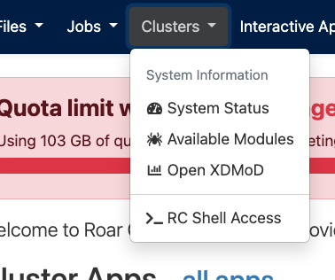
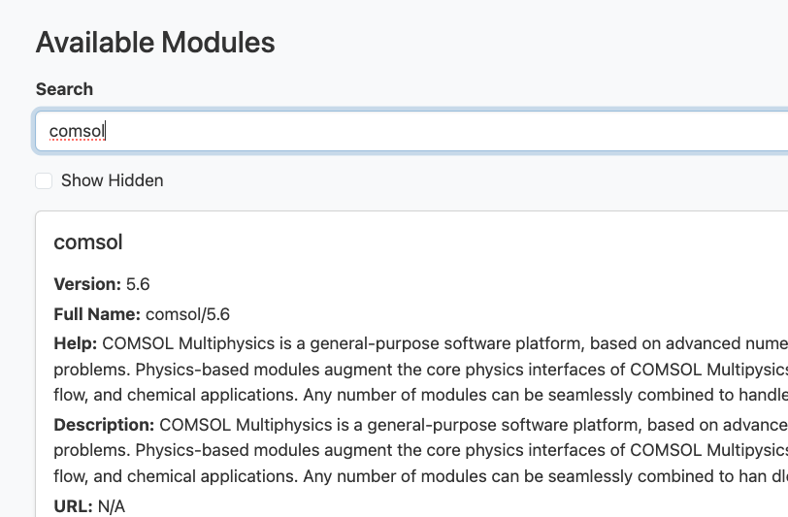
Finding Available Software - Portal

Slide 50
Lmod Commands
Command | Action
module avail | Lists all modules that are available to be loaded
module show <module_name> | Shows the contents of a module
module spider <module_name> | Searches the module space for a match
module load <module_name>/<version> | Loads a module or multiple modules if given a space-delimited list of modules
module unload <module_name> | Unloads a module or multiple modules if given a space-delimited list of modules
module list | Lists all currently loaded modules
module purge | Unloads all currently loaded modules

Slide 51
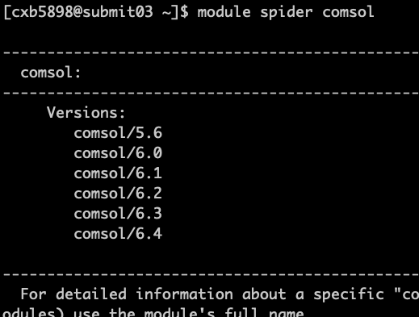
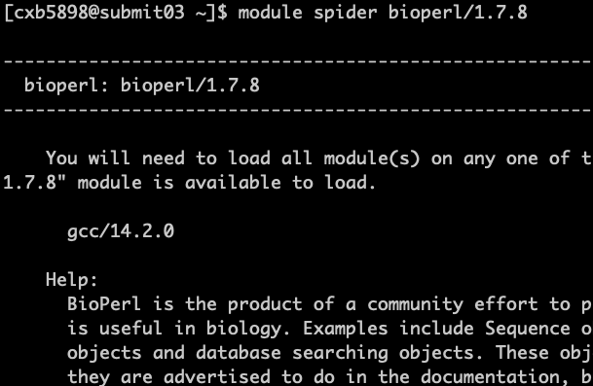
Finding Available Software - CLI

Slide 52
Hands-On
Pick a software package that you use for your research
  Do we have the software available?
  What versions exist?
  How do you load the software?

Slide 53
Software Versions on RC
Be sure to use consistent software versions. Always specify versions when loading modules to maintain consistency.
This is especially true for Python and R.
RC has several versions available for many software modules, and when a package is installed for one version, it is not always accessible by another version.

Slide 54
What if I want to use something else?
Users are allowed (and encouraged) to install their own software by:
  Compiling from source
  Creating Anaconda environments
  Using Apptainer Containers
Best effort installations or installation support upon request: https://tinyurl.com/ICDS-Software-Req

Slide 55

Install Python Packages with pip
Python packages can be installed using pip with the following:
pip install --user <package>
The --user option installs the package in the ~/.local directory and must be used since pip wants to install the package to system locations.
RC is a shared system, so users have access to user locations but do not have access to system locations.

Slide 56

Install R Packages
R manages some dependencies and versions through the CRAN-like repos. R packages can be installed from within the R console with the following command:
install.packages( <package> )
After installation, packages can then be loaded using the following command in the R console:
library( <package> )
It is always wise to review dependencies of any packages you would like to install because you may have to load additional software in your environment before launching the R console.

Slide 57
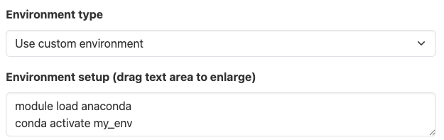
Package Management with Anaconda
Users can install their own miniconda or use the Anaconda modules to set up their own package environments
conda create –n env_name
conda activate env_name
conda install pkg_name
conda deactivate
Note: Creating packages must be done within a job
Additional info: https://docs.icds.psu.edu/packages/anaconda/

Slide 58
Client Support at ICDS
Contact us at icds@psu.edu
Office Hours
  Every Thursday and Friday from 12 pm to 1 pm on Zoom
https://docs.icds.psu.edu/getting-started/getting-help/

