Slide 1
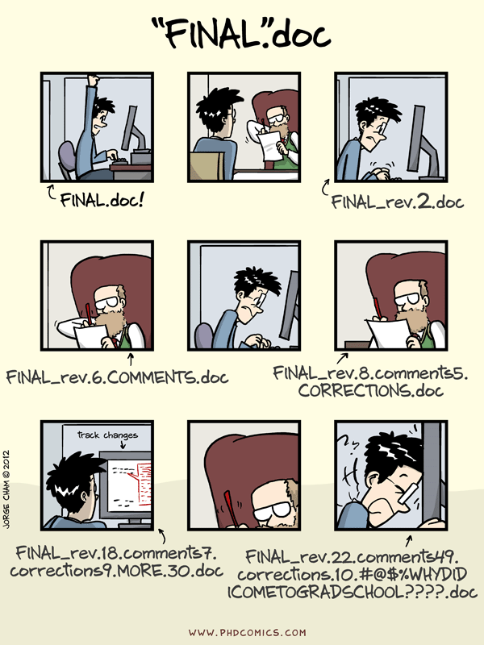
A Gentle Introduction to Git
A Graphical Overview of Version Control for Computational Workflows
Carrie Brown – carrie.brown@psu.edu
Client Support Lead
Institute for Computational and Data Sciences

Slide 2



Topics
What is Version Control and Git?
Anatomy of a Repository
Basic Git workflow
Local vs Remote repositories
  Cloning Existing Repos
  Push and Pull changes
  Merging and Conflicts
Advanced Git Features

Slide 3
What is Version Control?
Easy and powerful way to track changes to your work
Unlimited “undo”
General coding safety net
Cleaner file system
Useful for both code and writing (if using e.g. LaTeX)
Backups of your work and record of your edits
Collaborate!
“The whole idea behind any version control system is to store “safe” copies of a project so that you never have to worry about irreparably breaking your code base.” – bitbucket.org

Slide 4
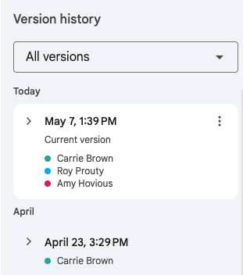
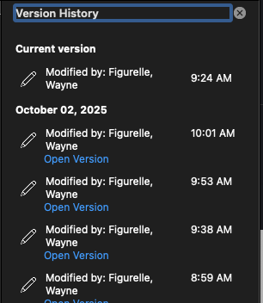
Version Control in Google and Microsoft

Slide 5

What is Git? How does it work?
Git tracks changes to a file (or set of files) through a series of snapshots called “commits” or “revisions”.

Slide 6
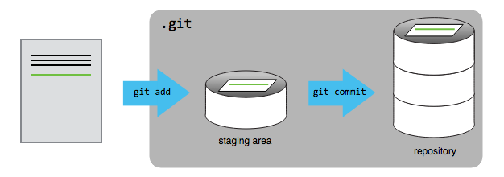
What is Git? How does it work?
These snapshots are stored in a “repository” which contains a history of all the changes to the files.

Slide 7
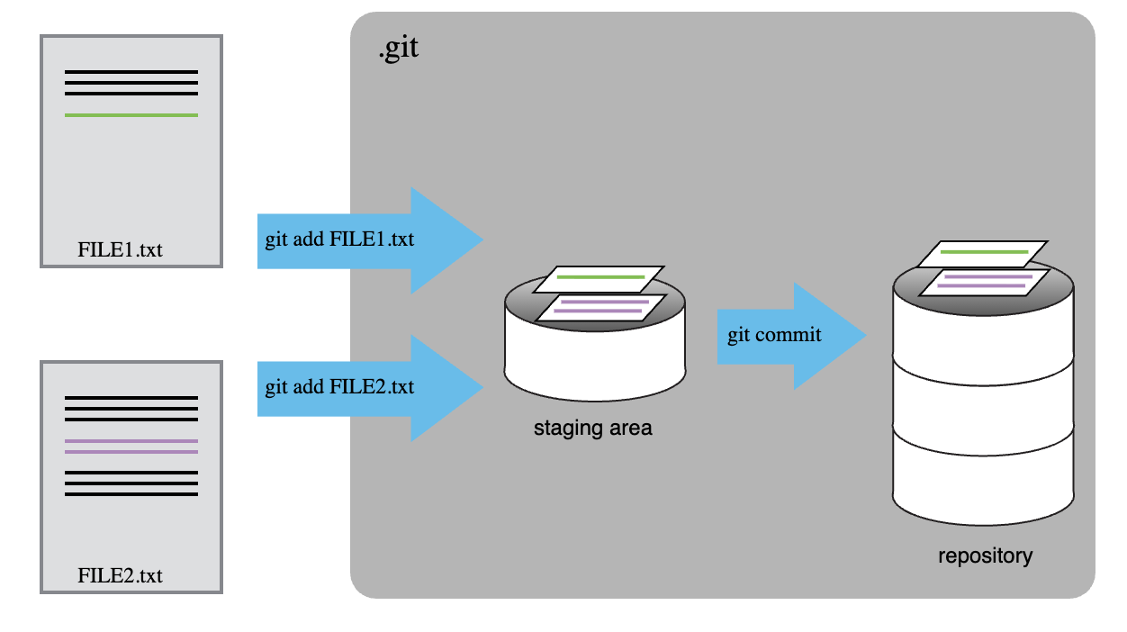
What is Git? How does it work?

Slide 8
How is Git useful to me?
“Why isn’t it working all of a sudden?”
Cleaner file system
  no more “code, codev2, codev3_test, codev3_test1” directories
Record of your edits (and thought process!)
Check for bugs in inconsistent results
Unlimited and powerful “undo”
Collaboration!

Slide 9
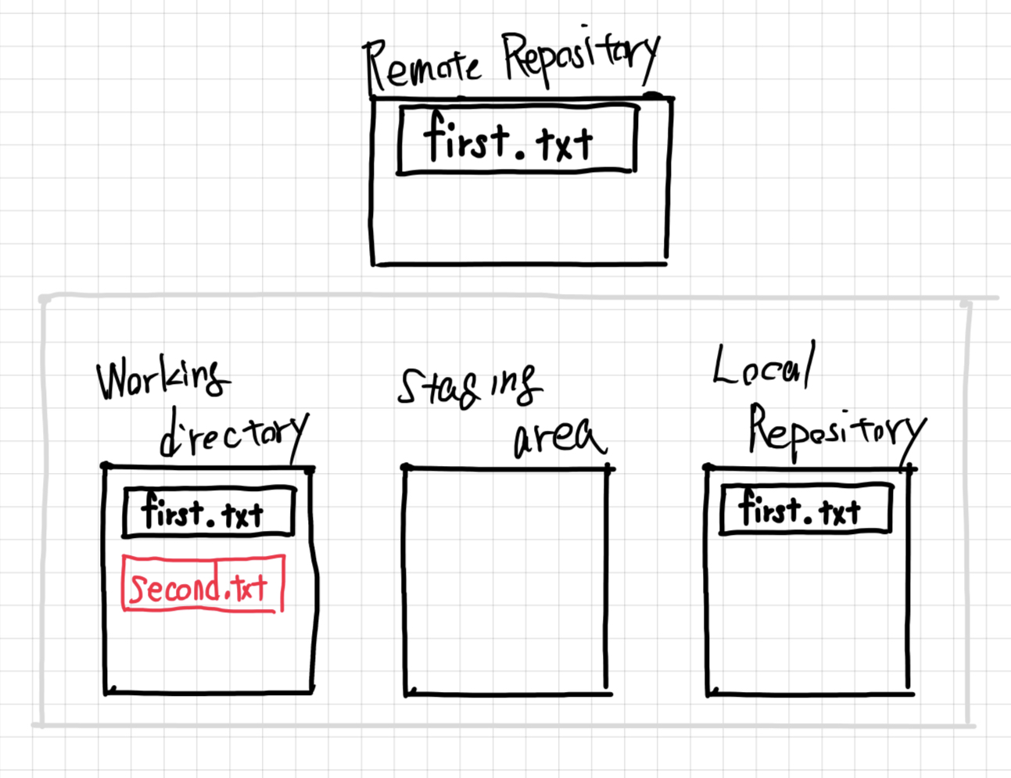
Anatomy of a Repository

Slide 10
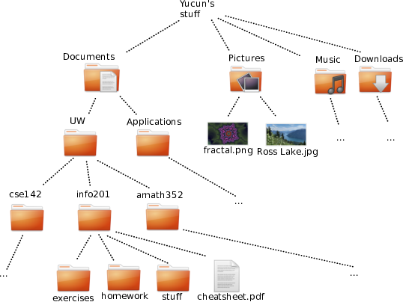
Working Directory (local)
My Computer
Classes
Research

Slide 11
Example Repository

Slide 12
Adding a New File

Slide 13
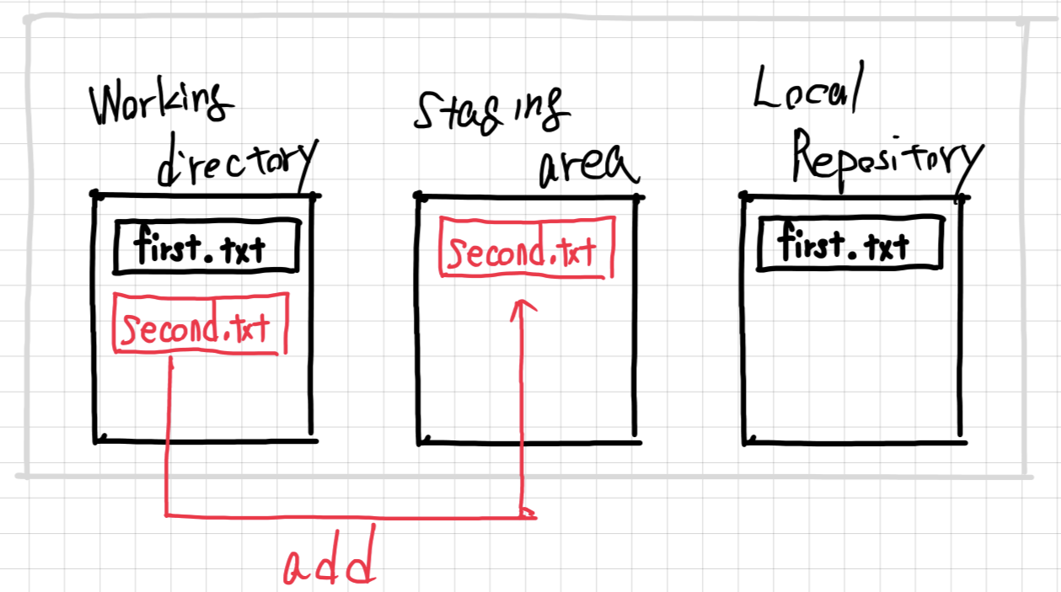
Stage the Changes

Slide 14
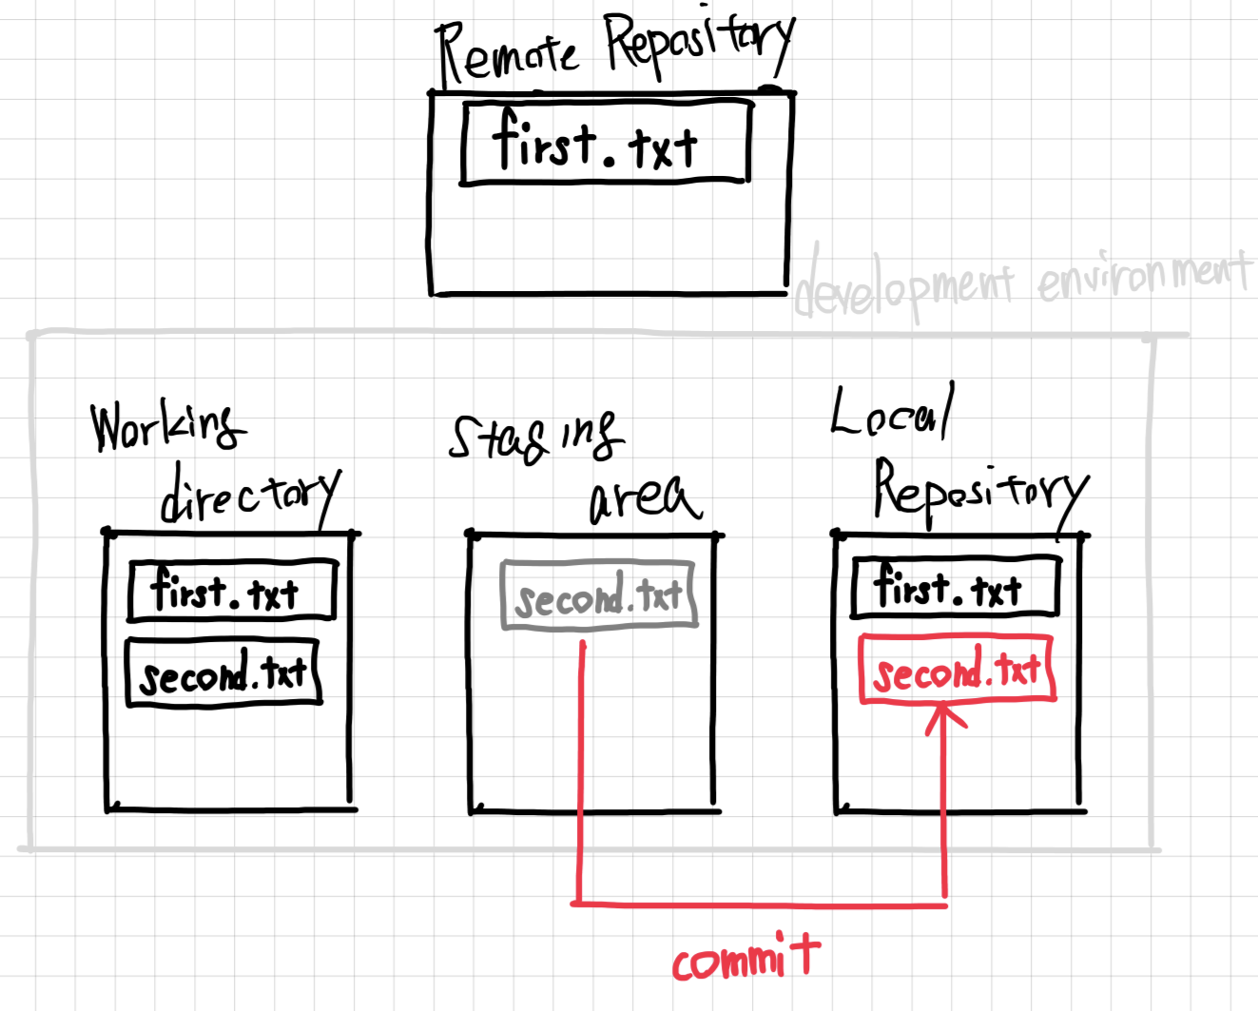
Commit the changes
Commit the Changes

Slide 15
Current State – after commit
Revision History

Slide 16
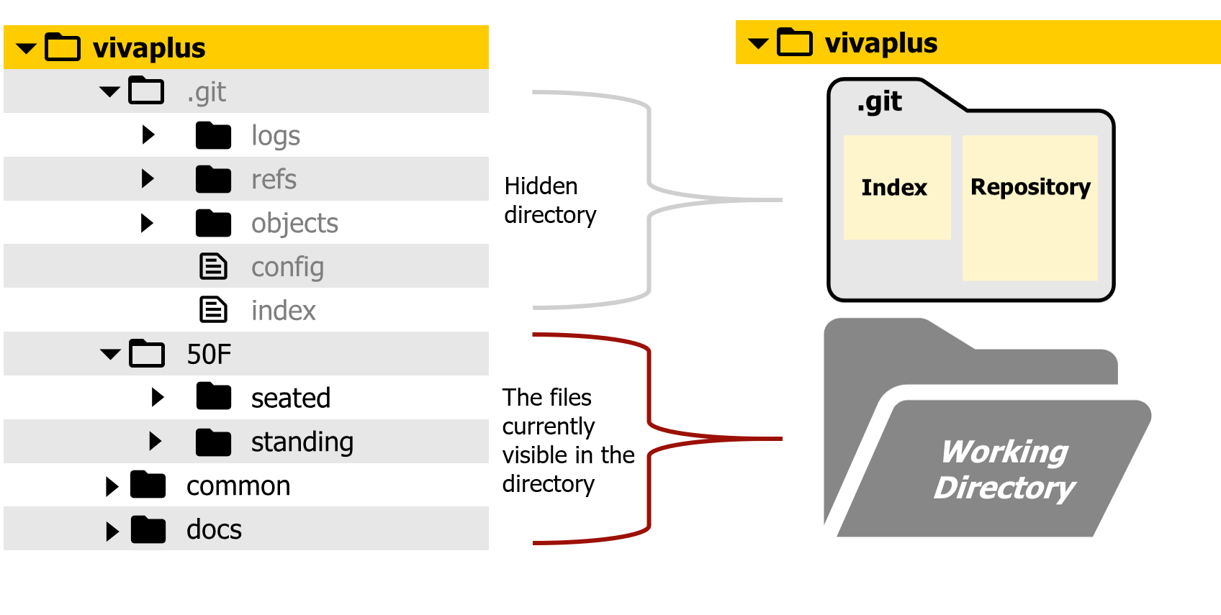
How it works
project
project

Slide 17
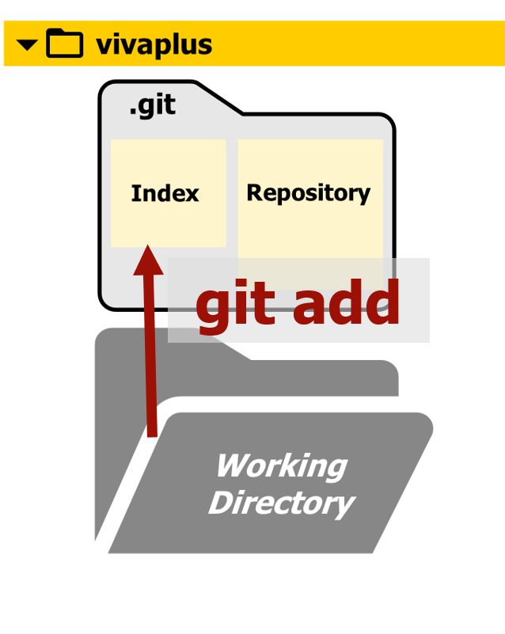
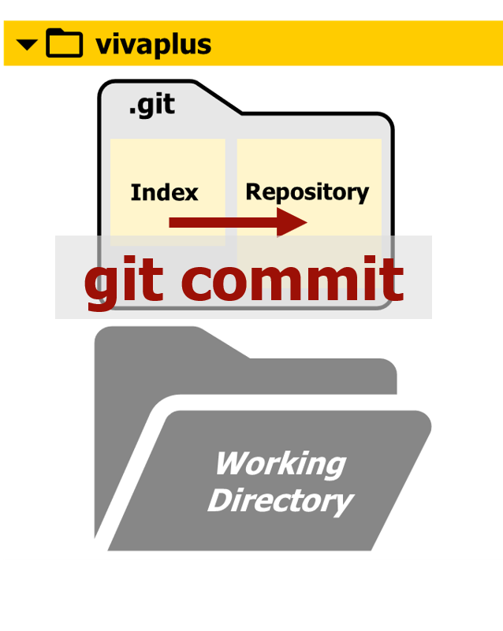
How it works
project
project

Slide 18
Good Workflow Tips
(At least one) repository per project or purpose
commit messages are a story, so don’t mix stories lines
Commit changes either:
As a complete thought – when you’ve finished a change
Before leaving the work – draft states are fine, but mention in commit message if you left it in an unstable/broken state
Write good commit messages
Informative at a high level but not too specific or vague
In 6 months, will this make sense and be helpful?
repositories should (mostly) be self-contained and stand alone

Slide 19
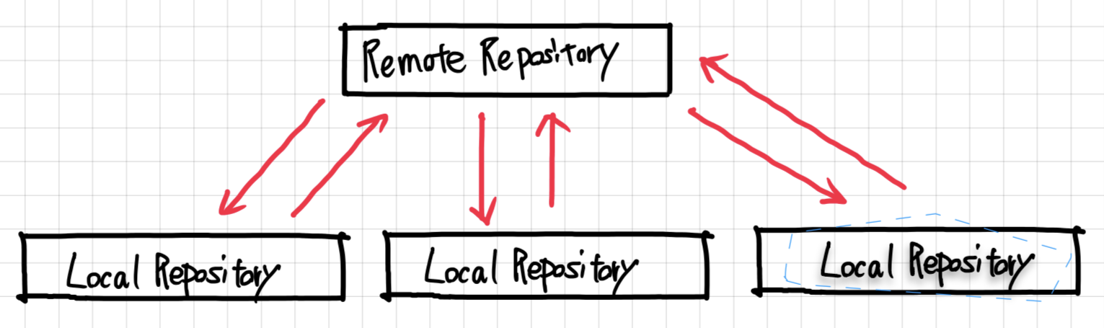
Local vs Remote Repositories
A remote repository is one that is stored or hosted on a remote (cloud) site such as: GitHub, GitLab
Each collaborator stores their own copy of the repository on their own machine – this is a local repository

Slide 20
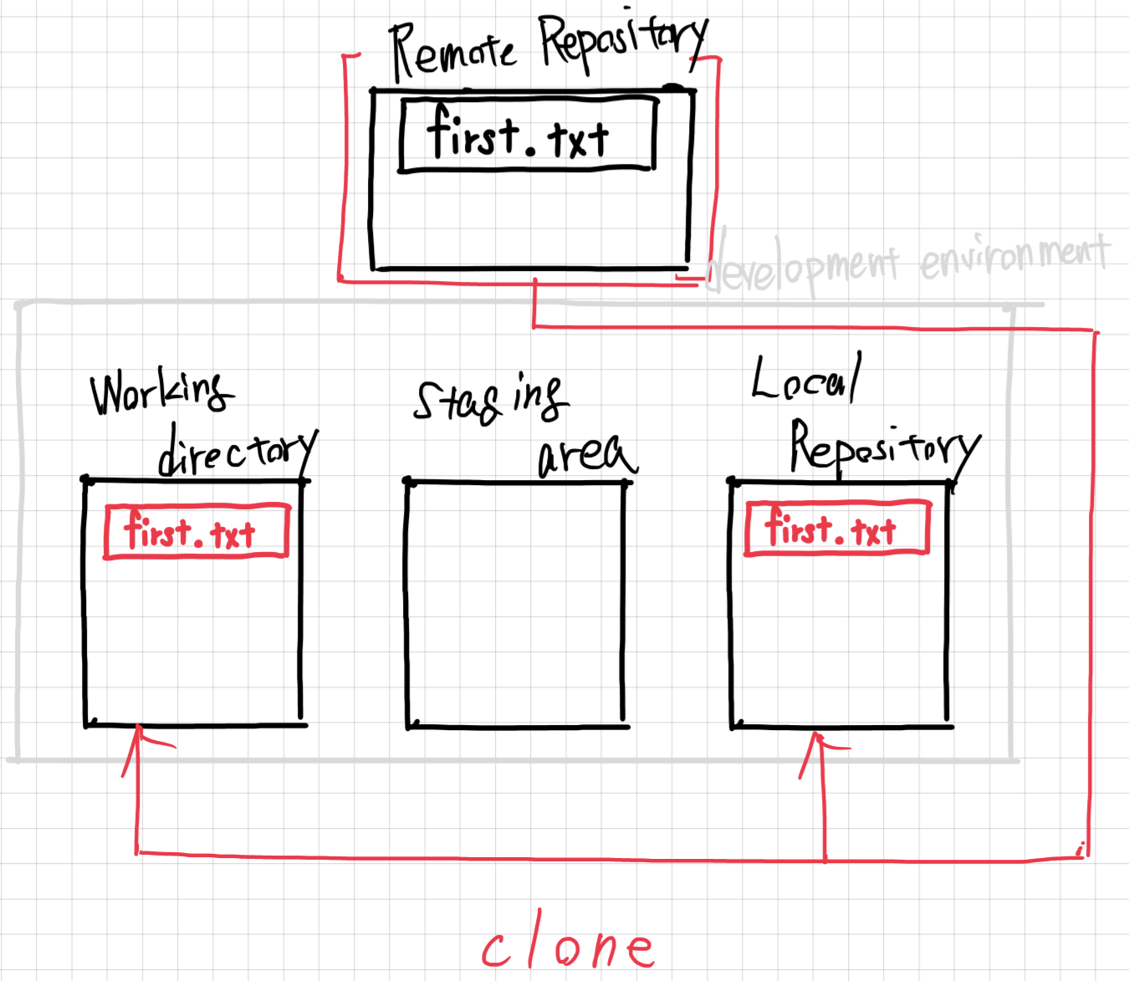
Clone an Existing Repository

Slide 22
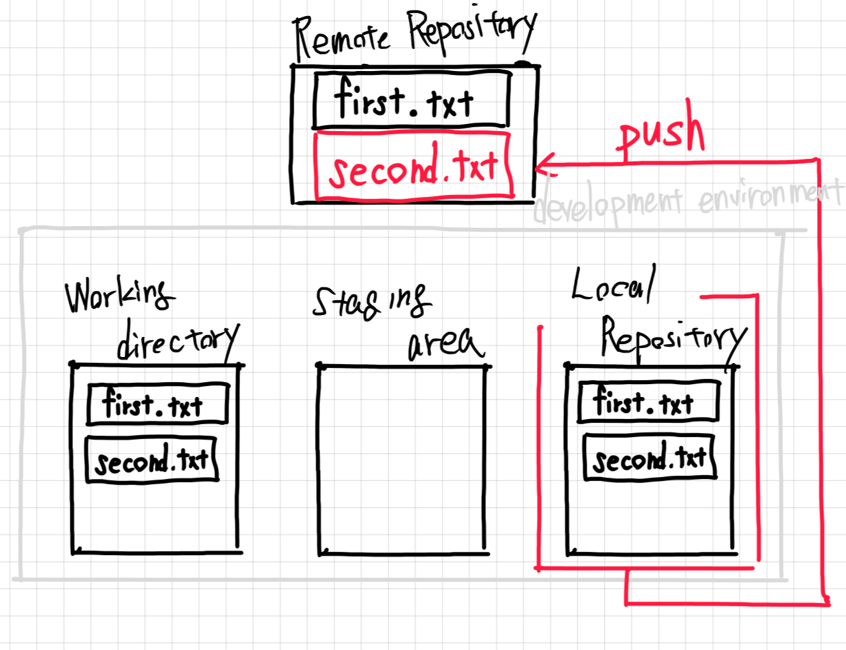
Changes to the remote repository

Slide 23
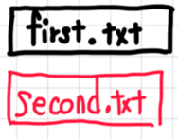
Pull New Changes from Remote
pull

Slide 24
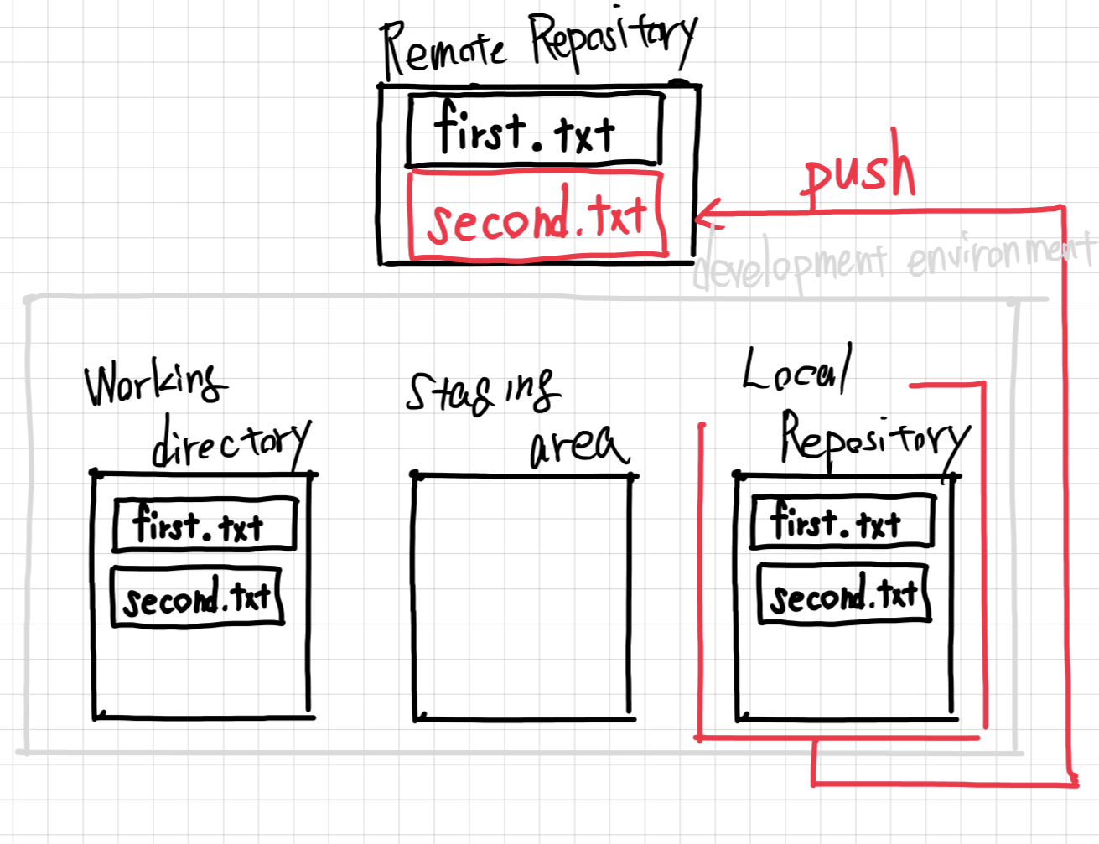
Changes to the local repository

Slide 25
Push new changes from Local

Slide 26
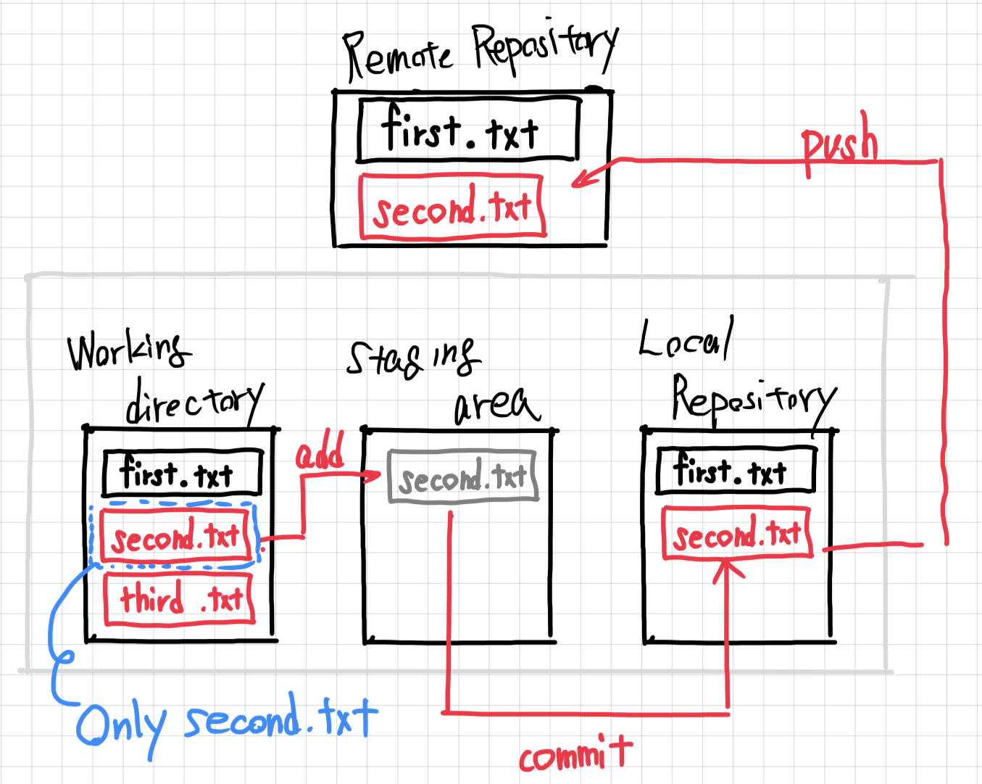
Strategically Stage Changes

Slide 27
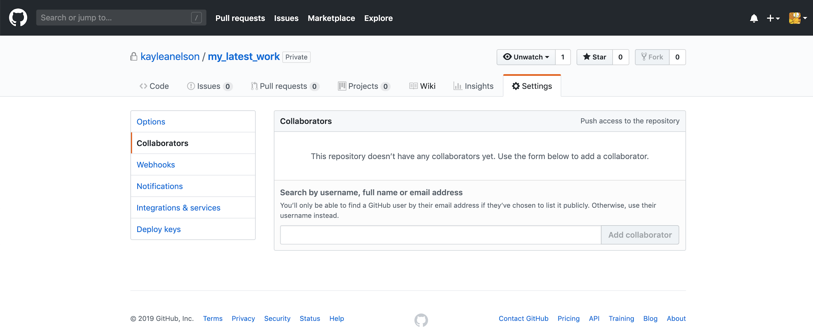
Sharing Your Repository

Slide 28
Basic Collaborative Workflow
Pull down new commits
Make your edits
Add your modified files and commit
Push commits to remote
$ git pull
…
$ git add <files>
$ git commit –m <message>
$ git push

Slide 29
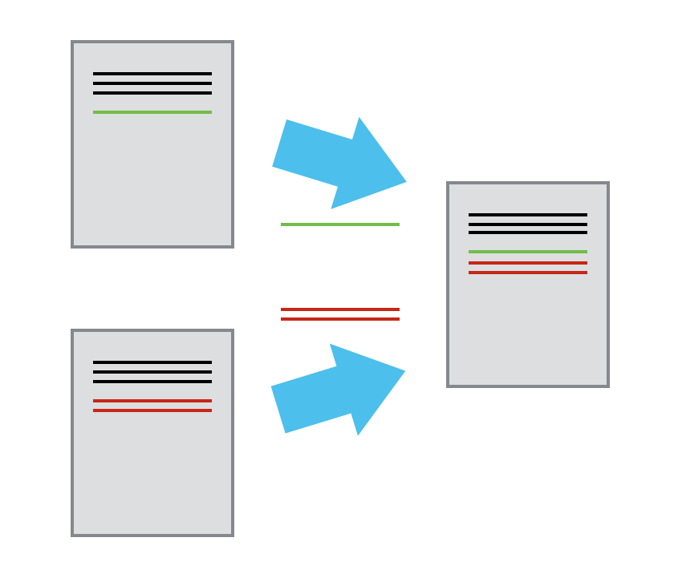
Merging
If collaborators make simultaneous changes to the repository, git will merge the changes.

Slide 30
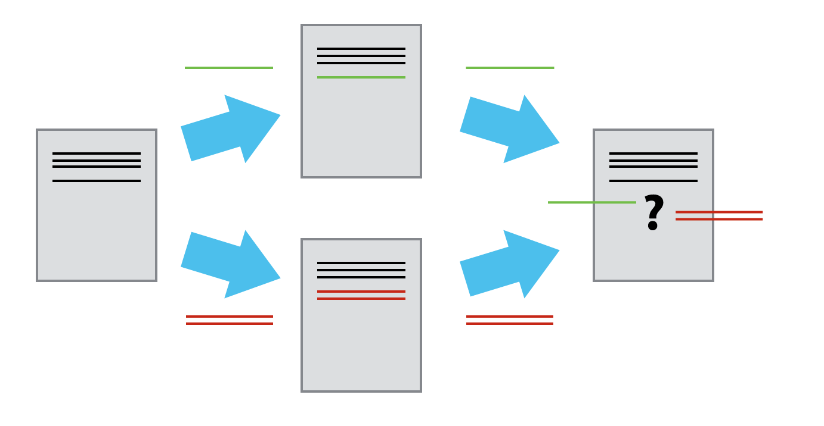
Conflicts
Inevitably, you and your collaborator will commit overlapping changes to a file. This will create a “merge conflict”.

Slide 31
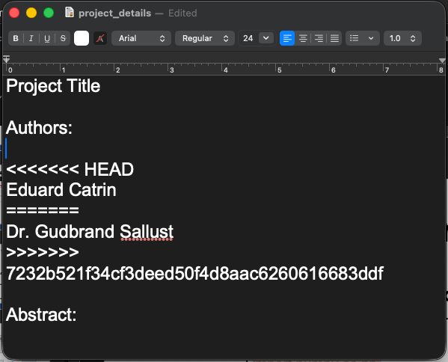
Resolving Conflicts
Git marks the conflicted line in the file
Manually merge the code in a text editor and commit the changes

Slide 32
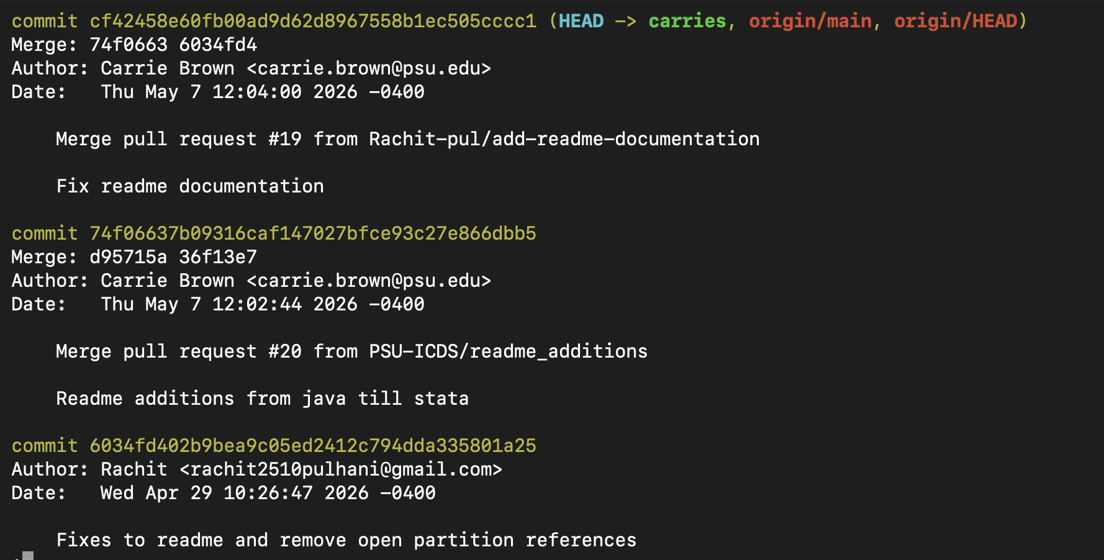
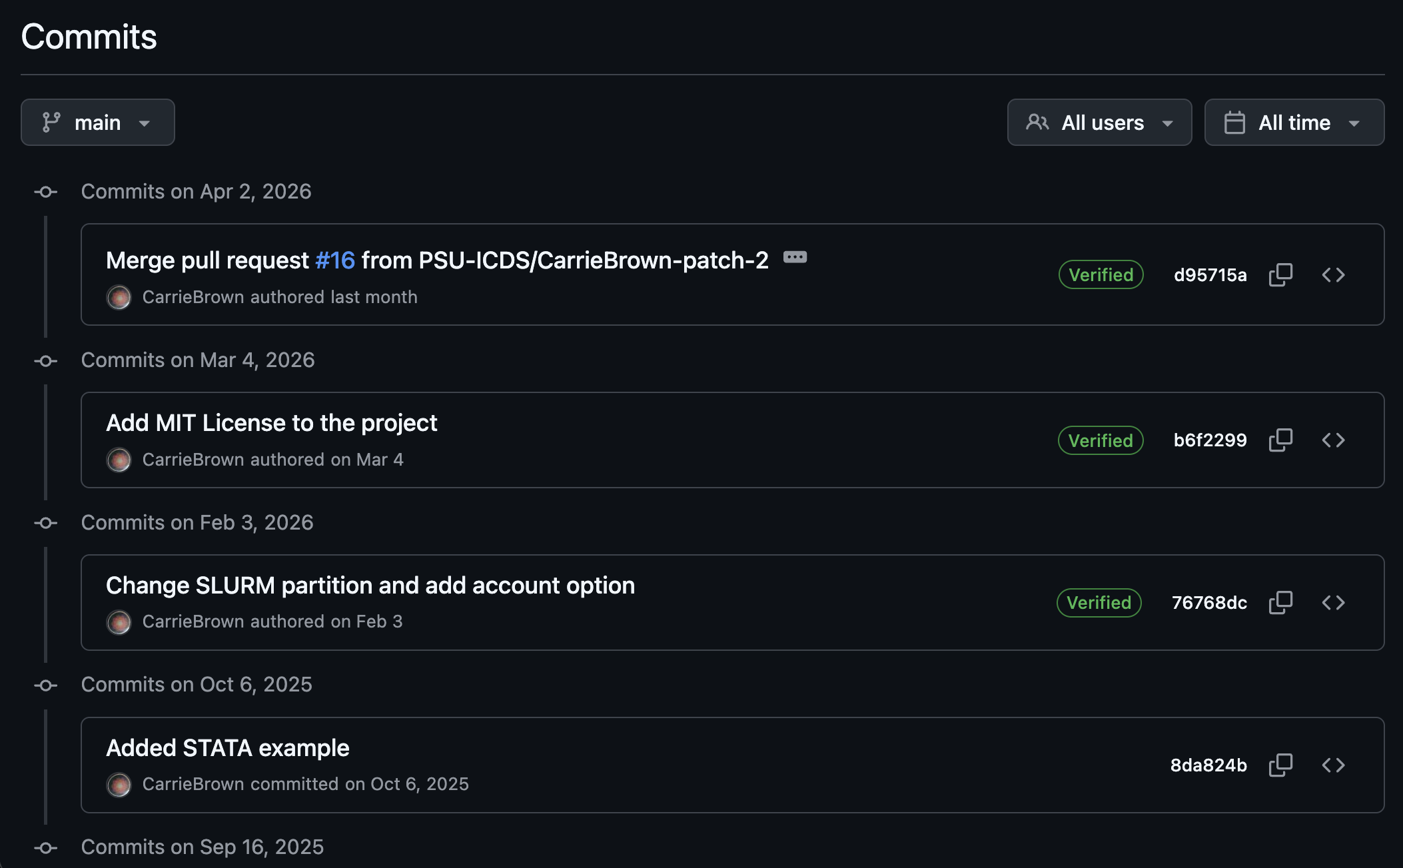
Repository History

Slide 33
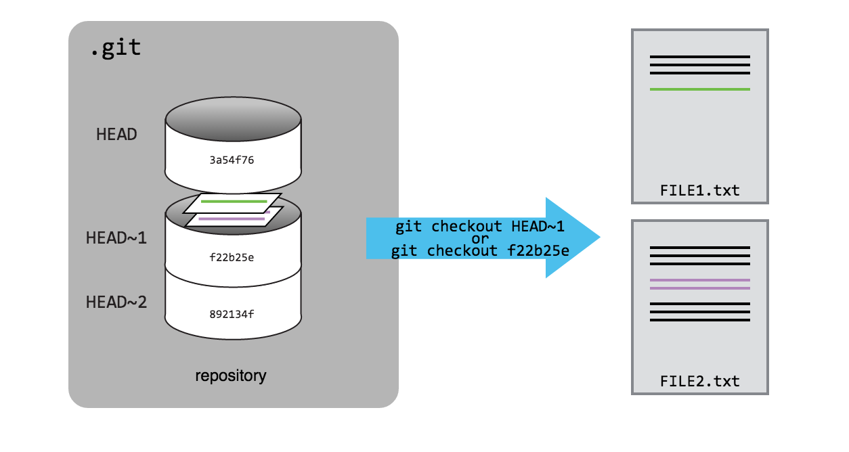
Checkout Previous Commits

Slide 34
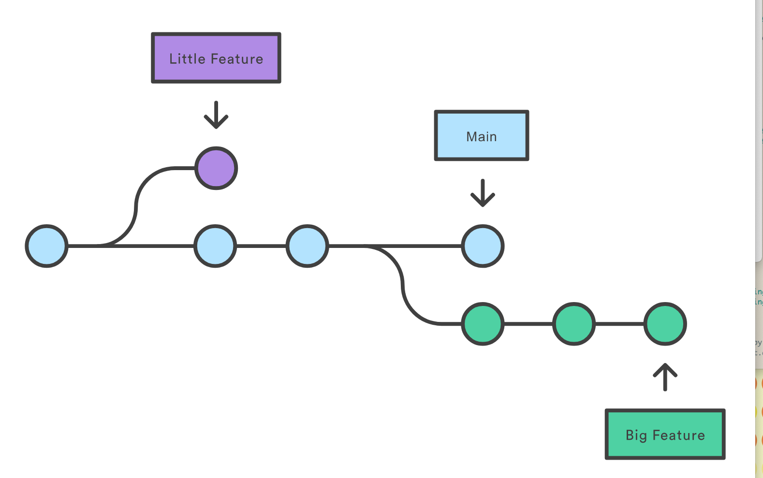
Branches
Each branch is an independent timeline for the project.

Slide 35
Common Branch Workflow
Allows for development while maintaining a stable “main”
keep “main” which is always in a functional state
create either one “devel” branch for changes or individual additional branches per new feature/large scale change

Slide 36
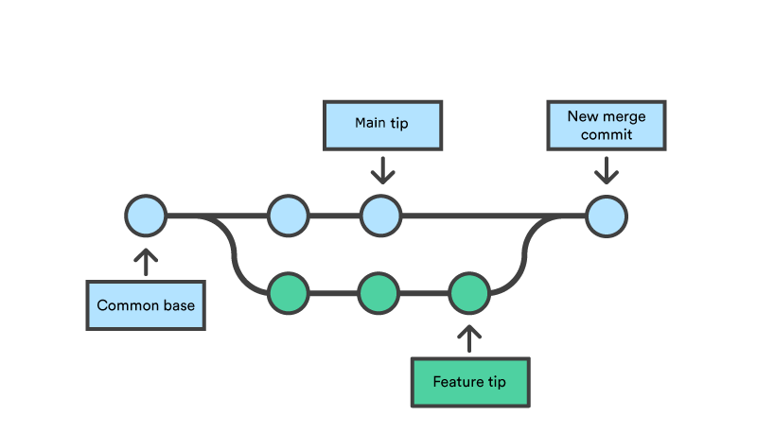
Merging a Branch
When you are confident in your changes, merge the development branch into your stable “main”

Slide 37
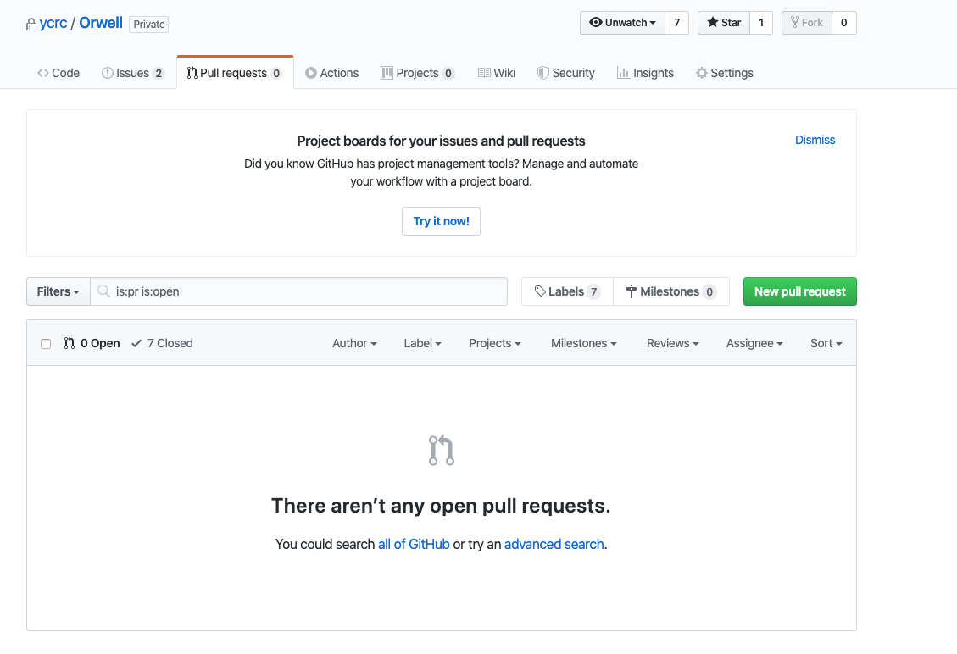
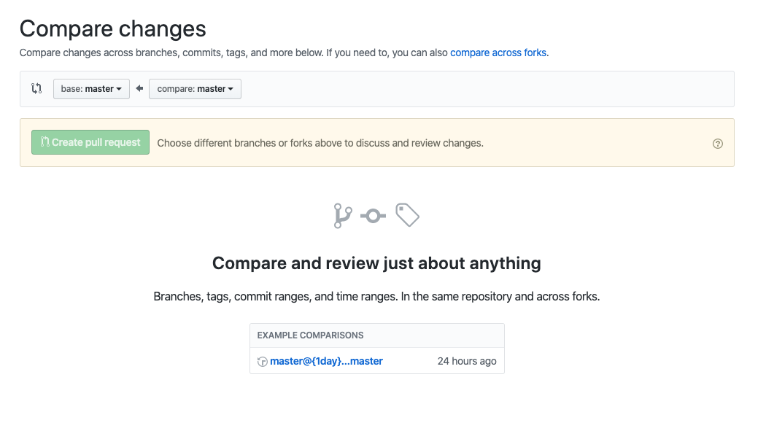
Merging in a Branch
Recommend to do a branch merge on Github using a “Pull Request”
You may either keep the branch open (devel) or close it upon merge (feature branch)

Slide 38
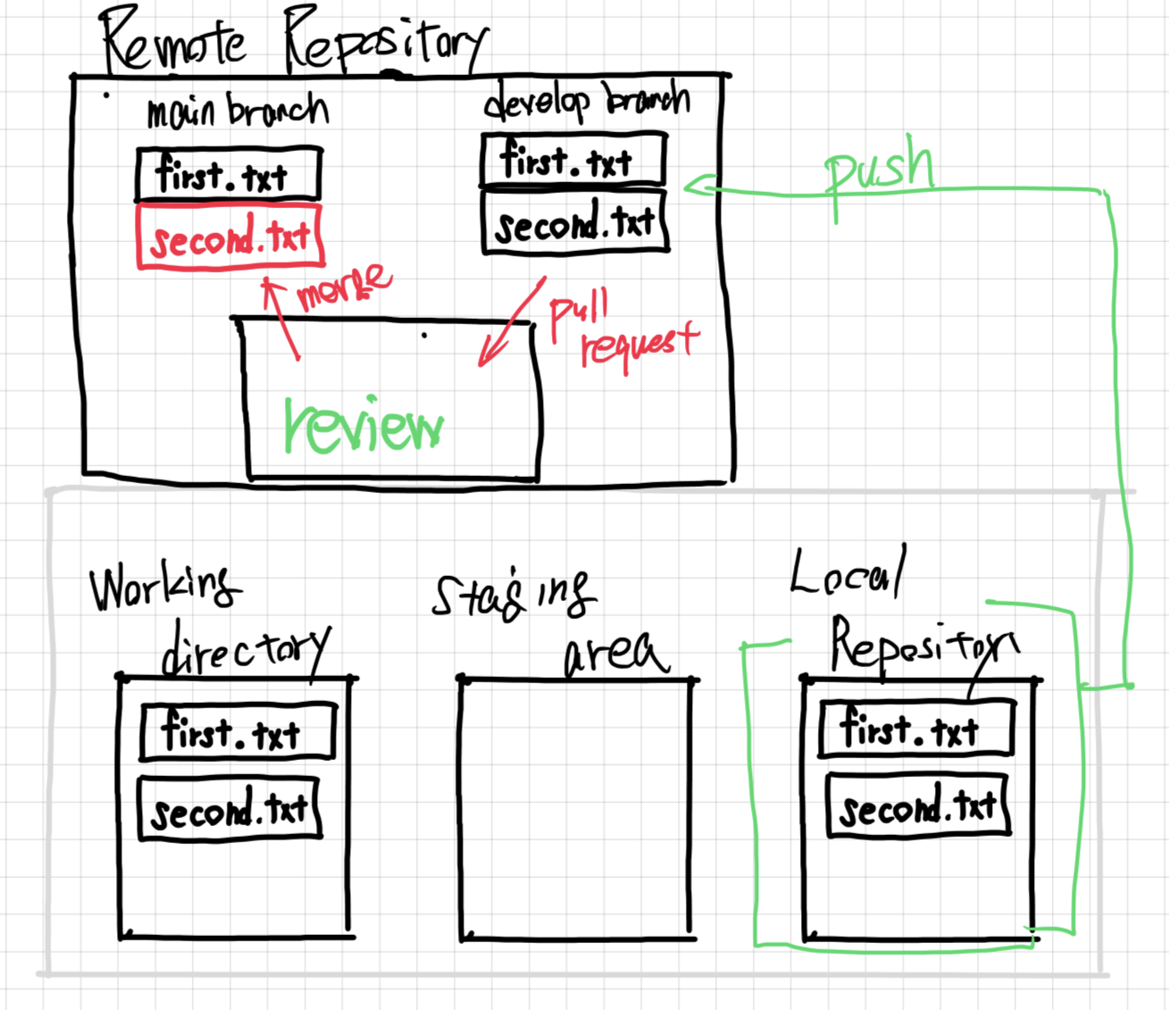

Slide 39
Advanced Git features
Ignore Files: have Git ignore transitory files such as data or output files
Collaboration: Add collaborators to your repository to all work together
CI/CD: Build actions, Releases, Issue tracking help manage collaborative projects to encourage crowdsourced effort
Publish: Get a DOI for your repository to reference in articles or other publications

Slide 40
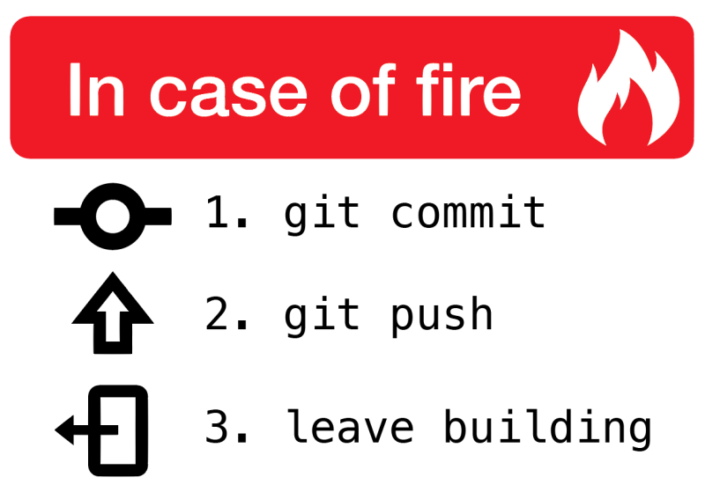
Any Questions?
More Information:
Great in-depth tutorials on all things git:
  try.github.io
  https://swcarpentry.github.io/git-novice/
Upcoming Hands-On Git workshop
  July 9th 12:30 pm – Details TBA
  If interested, add your name and email to the contact sheet
Acknowledgements:
Slides adapted from “Version Control with Git” by Kaylea Nelson – Yale Center for Research Computing
Images from:
  Software Carpentry Introduction to Git - https://swcarpentry.github.io/git-novice/
  Understanding Git through Images - https://github.com/nopeNoshishi/learn_git

